Slide 1
Naming Benzene compounds
QUEST Organic Chemistry

Slide 2
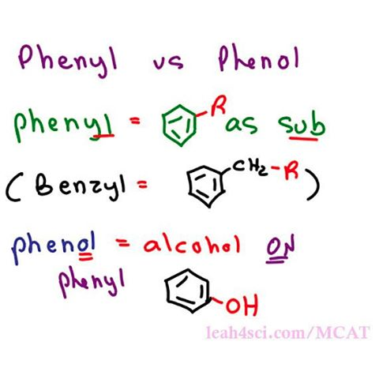
Benzene
Many organic compounds are based on benzene or contain benzene rings.
To avoid complex names, there are some shortcuts we can employ when naming compounds with a benzene ring.

Slide 3
Simple compounds
Some common substituents, like NO₂, Br, and Cl, can be named this way when it is attached to a phenyl group. Long chain carbons attached can also be named this way.
The general format for this kind of naming is: (positions of substituents (if >1)- +# (di, tri, ...) +substituent)n +benzene.
For example, chlorine (Cl) attached to a phenyl group would be named chlorobenzene (chloro + benzene). Since there is only one substituent on the benzene ring, we do not have to indicate its position on the benzene ring (as it can freely rotate around and you would end up getting the same compound.)

Slide 4
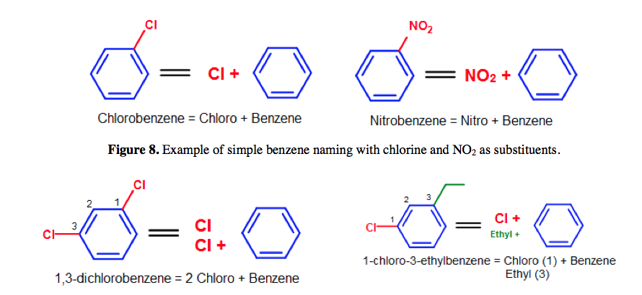
More complicated simple benzene naming examples - Note that standard nomenclature priority rules are applied here, causing the numbering of carbons to switch.

Slide 5
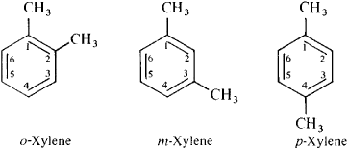
For 2 groups attached
Instead of using numbers to indicate substituents on a benzene ring, ortho- (o-), meta- (m-), or para (p-) can be used in place of positional markers when there are two substituents on the benzene ring (disubstituted benzenes). They are defined as the following:
ortho- (o-): 1,2- (next to each other in a benzene ring)
meta- (m): 1,3- (separated by one carbon in a benzene ring)
para- (p): 1,4- (across from each other in a benzene ring)

Slide 7
Ortho meta para
However, the substituents used in ortho-, meta-, para- nomenclature do not have to be the same. For example, we can use chlorine and a nitro group as substituents in the benzene ring.

Slide 8
To summarize

Slide 9
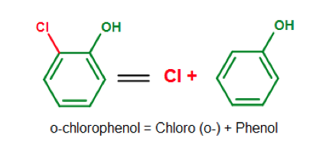
phenols
Benzene also has base names from its derived compounds. Phenol (C6H5OH), a benzene ring with a single alcohol group, for example, serves as a base when other substituents are attached to it. This is best illustrated in the diagram below.
Note that phenol would no longer be the base if the the second substituent were an OH.

Slide 10
Phenols
Alternatively, we could name it using the numbering system.
Because we are using phenol as the base molecule, the OH automatically gets place #1.

Slide 11
phenols
The normal priority rules then apply in the nomenclature process (give the rest of the substituents the lowest numbering as you could).

Slide 12
Below is a list of commonly seen benzene-derived compounds. Some of these mono-substituted compounds (labeled in red and green), such as phenol or toluene, can be used in place of benzene for the chemical's base name.

Slide 13
example

Slide 14
Common vs IUPAC systematic names
According to the indexing preferences of the Chemical Abstracts, phenol, benzaldehyde, and benzoic acid (labeled in red in Figure 16) are some of the common names that are retained in the IUPAC (systematic) nomenclature.
Other names such as toluene, styrene, naphthalene, or phenanthrene can be used by the IUPAC discourages putting substituents on these names.
Nomenclature for compounds which has such discouraged names will be named by the simple benzene naming system.
An example of this would include toluene derivatives like TNT. (Note that toluene by itself is retained by the IUPAC nomenclature, but its derivatives, which contains additional substituents on the benzene ring, might be excluded from the convention). For this reason, the common chemical name 2,4,6- trinitrotoluene, or TNT, as shown in figure 17, would not be advisable under the IUPAC (systematic) nomenclature.

Slide 16
Ortho meta para
Since the IUPAC nomenclature primarily rely on the simple benzene naming system for the nomenclature of different benzene derived compounds, the OMP (ortho-, meta-, para-) system is not accepted in the IUPAC nomenclature.
For this reason, the OMP system will yield common names that can be converted to systematic names by using the same method as above.
For example, o-Xylene from the OMP system can be named 1,2- dimethylbenzene by using simple benzene naming (IUPAC standard).

Slide 17
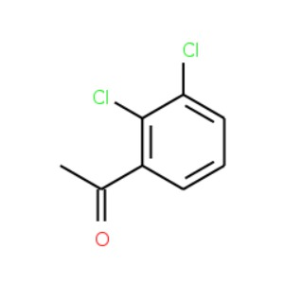
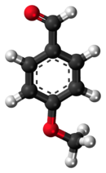
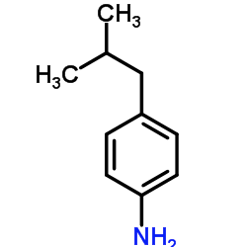
Name these
Use both ortho, meta, para nomenclature and IUPAC numbering when possible.
Notes:
1) Use anisole as the base

Slide 18
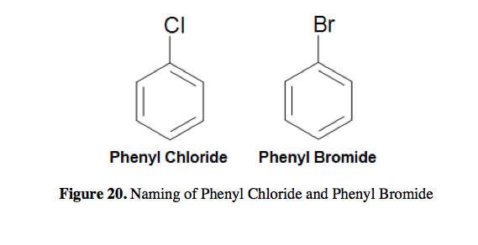
Phenyl groups
The phenyl group (Ph-R, C6H5-R) can be formed by removing a hydrogen from benzene and attaching a substituent to where the hydrogen was removed.
To this phenomenon, we can name compounds formed this way by applying this rule: (phenyl + substituent). For example, a chlorine attached in this manner would be named phenyl chloride, and a bromine attached in this manner would be named phenyl bromide.

Slide 19
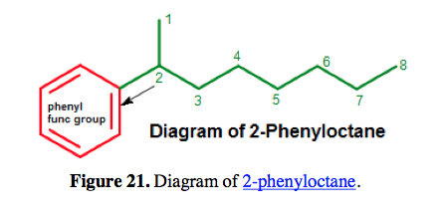
Phenyl Group
While compounds like these are usually named by simple benzene type naming (chlorobenzene and bromobenzene), the phenyl group naming is usually applied to benzene rings where a substituent with six or more carbons is attached.

Slide 20
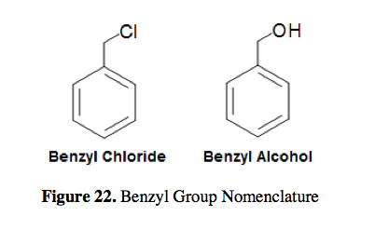
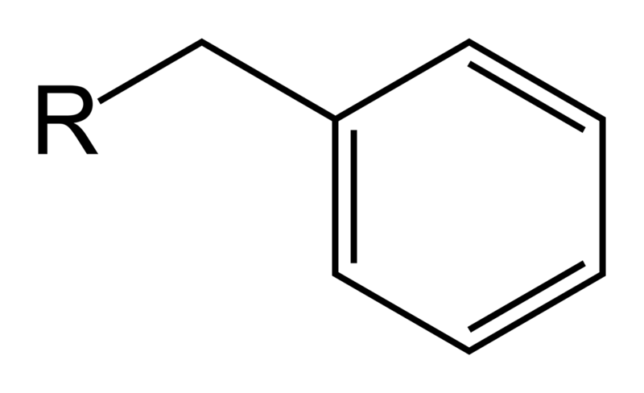
Benzyl group
Just a benzene ring with a CH₂ attached!

Slide 21
clarification
Be careful not to confuse a phenyl (pronounced fenyl) group with the compound phenol (pronounced feenol).
A general and useful generic notation that complements the use of R- for an alkyl group is Ar- for an aryl group (any aromatic ring).
Names like ortho- and meta- are usually ok for homework even though they are not encouraged by the IUPAC. Also, naming from a base like styrene or benzonitrile are fine unless the assignment asks otherwise.

Slide 22
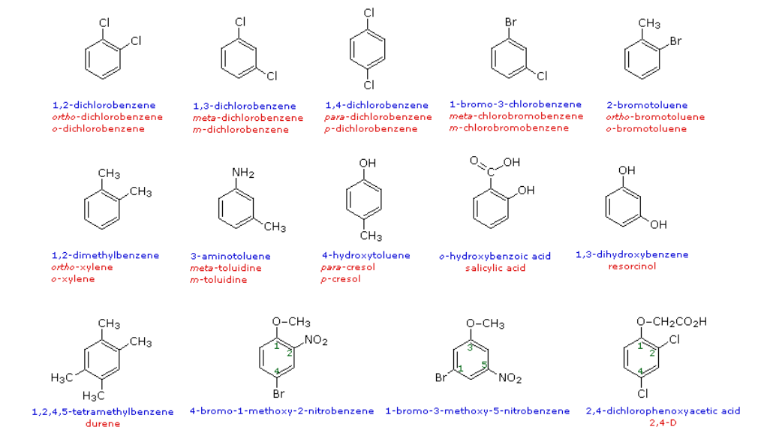

Slide 23
resources
See the benzene flowchart handout to help you when naming.
A website that explains this really well:
http://public.wsu.edu/~hemeteam/Chem116/Worksheets/BENZENE%20NAMING%20EXPLAINED.pdf

