Slide 1
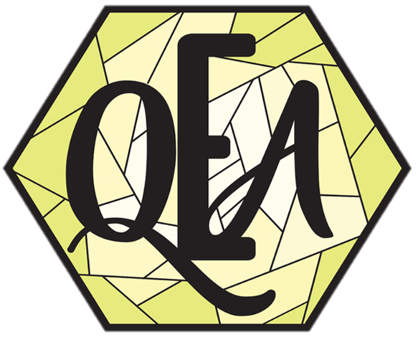
Chemical Bonding
Ionic and Covalent

Slide 2
What is a molecule?
A molecule is an electrically neutral group of at least two atoms held together by chemical bonds.
A molecule is the smallest particle in a chemical element or compound that has the chemical properties of that element or compound.
Bonding Makes Molecules.

Slide 3

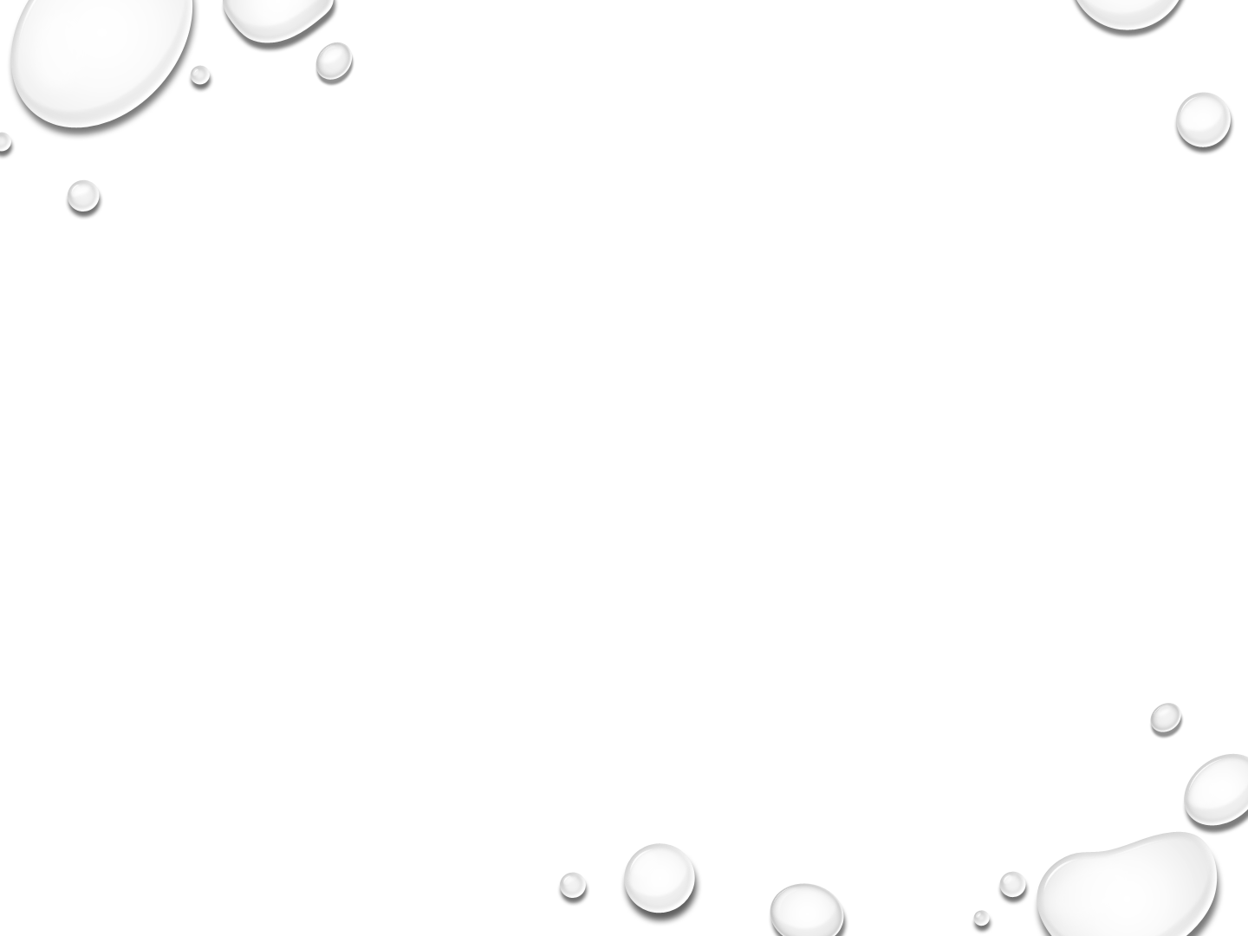
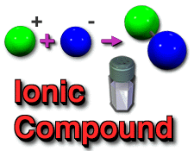
Ionic Bonds
The jumping bond
One atom loses an electron & becomes +.
One atom gains and electron & becomes -.
Both end up with a valence of 8.
The positive ion is attracted to the negative ion.
Usually occurs between metal and nonmetal.

Slide 4
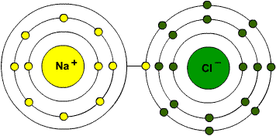
Ionic Bonds in Table Salt
In its solid form as table salt, the Na⁺ and the Cl⁻ ions are held in place in a crystalline lattice. When dissolved in water, the ions freely roam about the solution.

Slide 5
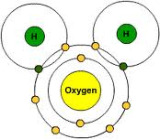
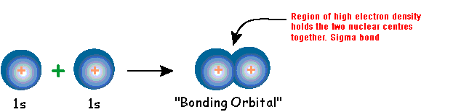
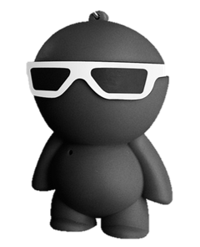
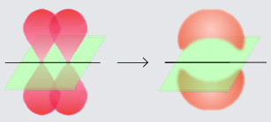
Covalent bonds
Covalent bonds share electrons.
Occur between nonmetals.
  Sigma bonds σ – overlap s orbitals
  Pi bond – π - overlap p orbitals

Slide 6
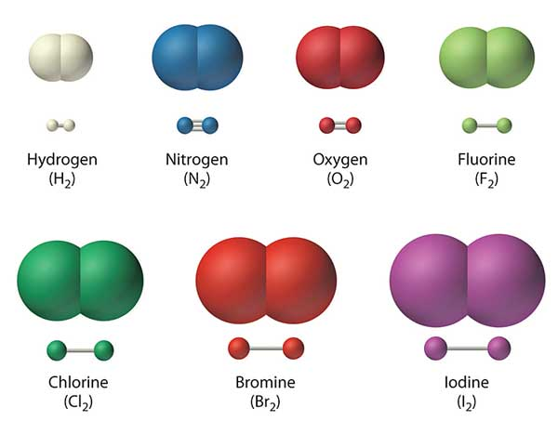
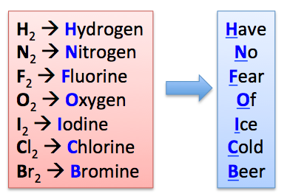

Diatomic molecules
Two atoms of the same or different elements bound together into a molecule.
Single elements that make homonuclear diatomic molecules
At₂ → Astatine And
No, this does not mean you should go drink beer.
Examples of 2 elements making diatomic molecules
  CO, NO, NaCl, HF, HCl, HBr

Slide 7
Differences between Ionic and Covalent bonds
Ionic Bonds | Covalent Bonds
Crystalline Solids | Gases, Liquids, or Solids
High Melting Points and Boiling Points | Low Melting and Boiling Points
Soluble in Water but Not in Alcohol | Soluble in Alcohol but Not Water
Conducts Electricity | Poor Electrical Conduction

Slide 8
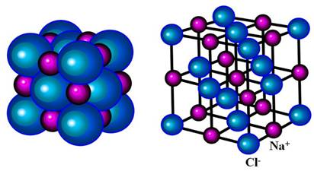
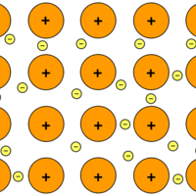

Ionic and Metallic bond structure
Ionic
1) + lined up with –
2) Shifts in jumps
3) Clean break along the sides of crystal.
Metallic
Electron Sea Model
Valence electrons are given up into a sea of charges
https://www.youtube.com/watch?v=Bjf9gMDP47s
Check out this link, y’all. It will help you understand the material.

Slide 9
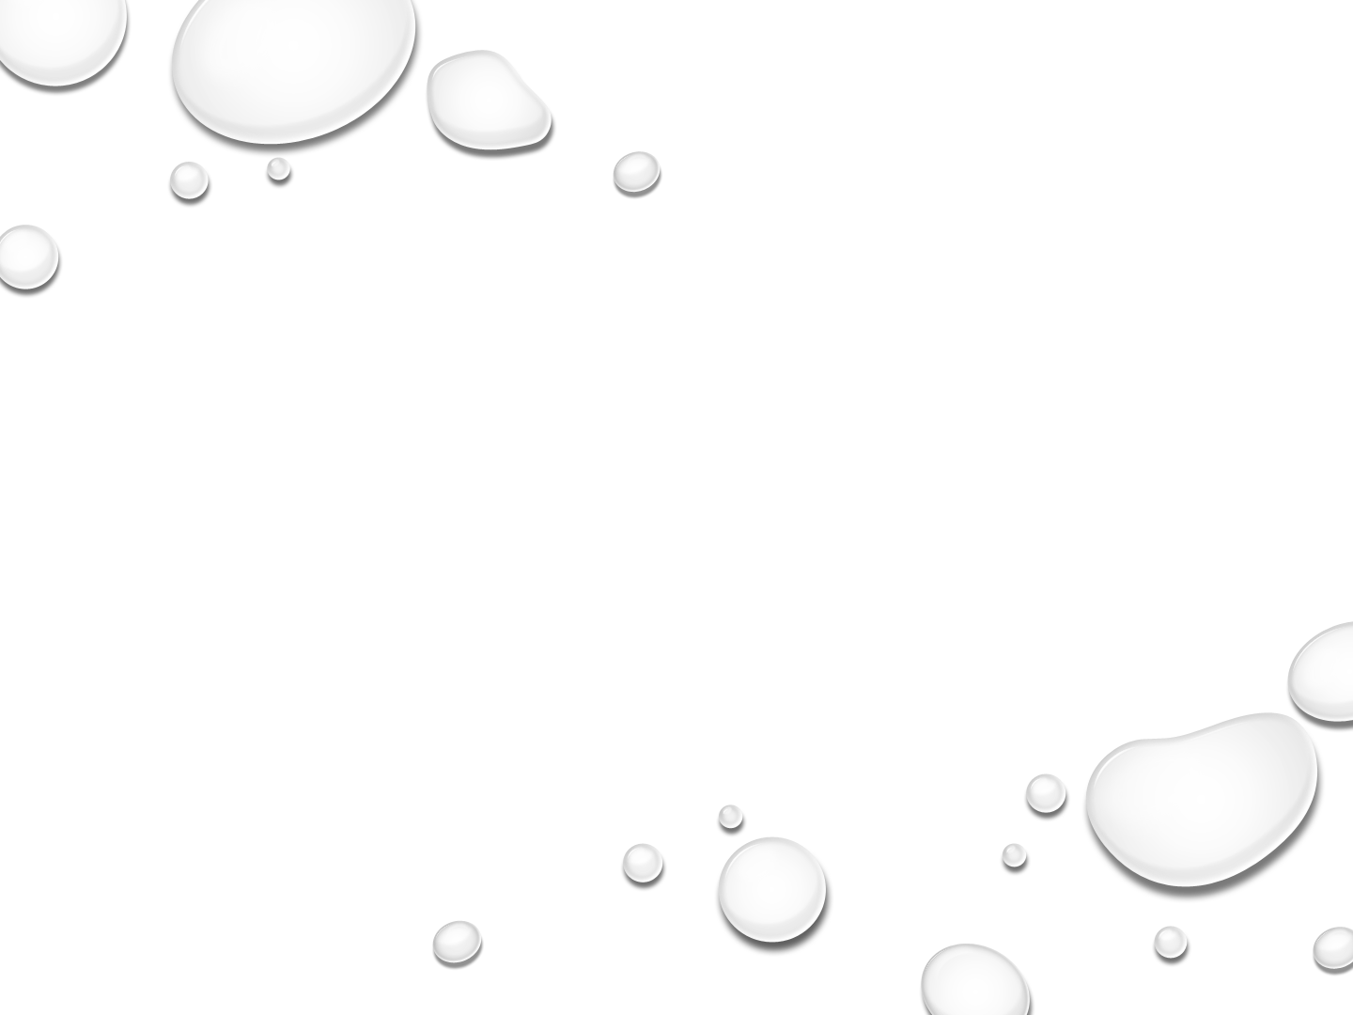
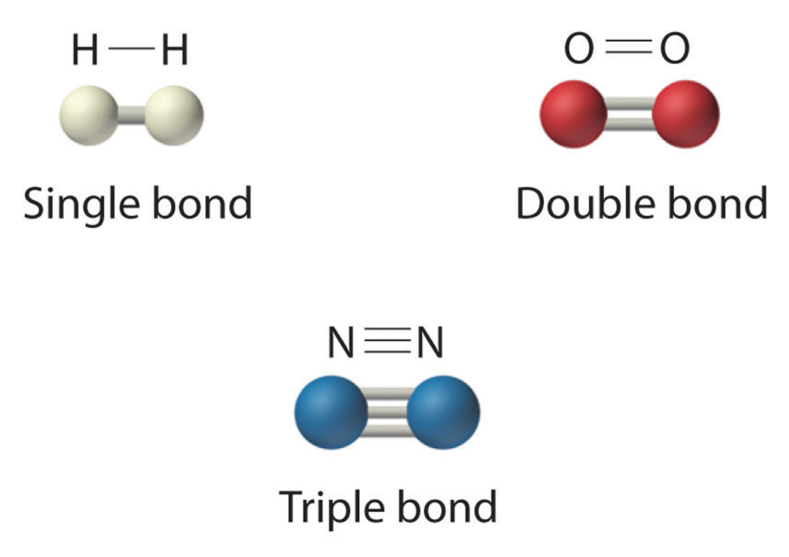
Number of Bonds

Slide 10
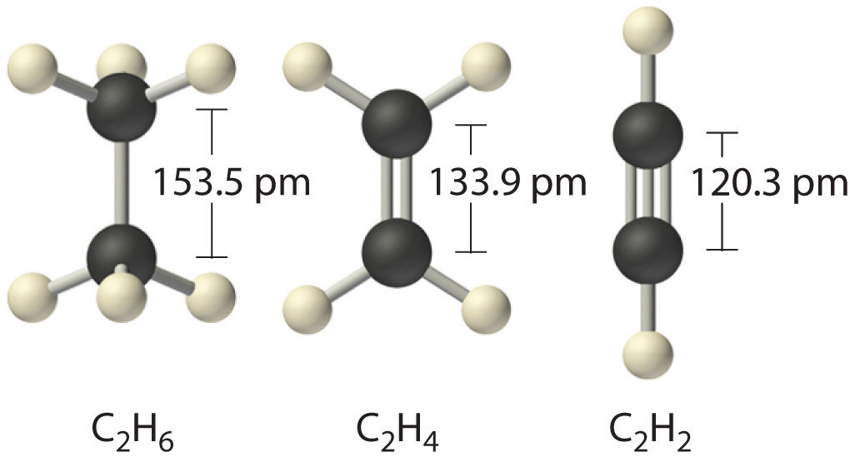
Bond Length
The shorter and tighter, the higher the number of bonds

Slide 11

Bond Energy and Stability
3 bonds contain the most energy and Stability.
2 bonds are intermediate for both.
1 bond contains the least energy and stability
More energy = More Stability.

Slide 12
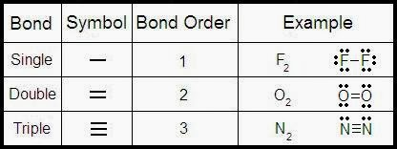
Bond Order on the Atomic Level
Nitrogen has an atomic level bond order of 3
Oxygen has an atomic level bond order of 2
Hydrogen has an atomic level bond order of 1
Atomic Bond level = The number of bonded electron pairs

Slide 13
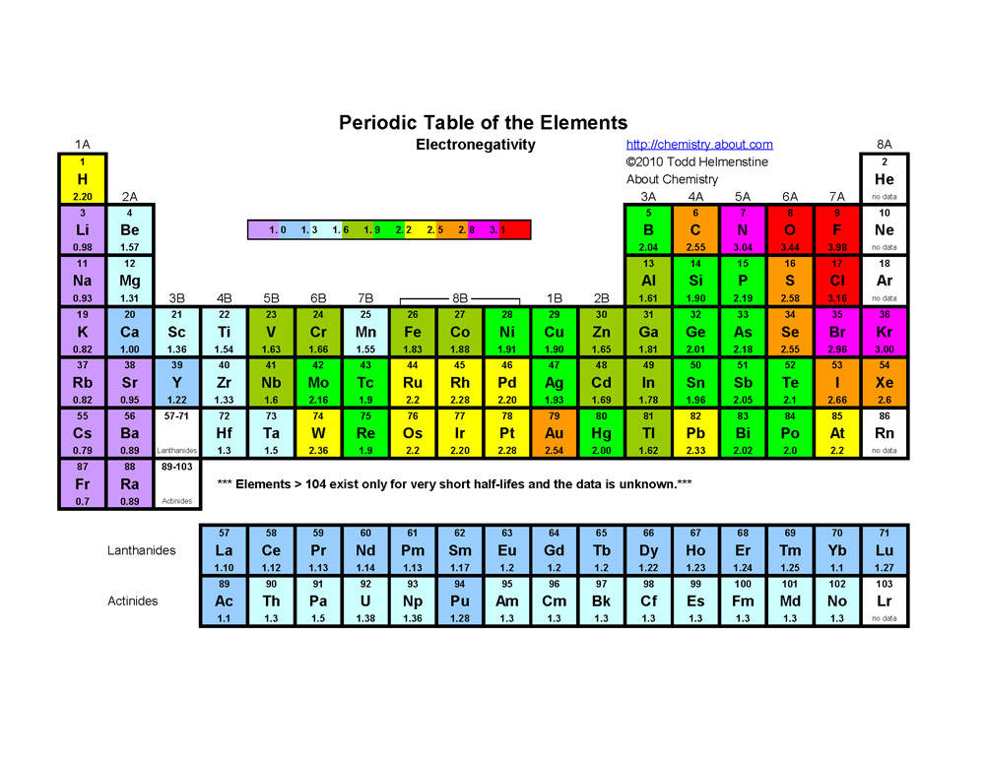
Electronegativity: The ability of an atom to attract electrons to itself

Slide 14
The Electronegativity Value
Quick facts:
Indicates the attraction of an atom for electrons, especially shared electrons.
Increases from left to right going across a period on the periodic table.
Is high for the nonmetals with fluorine as the highest.
Is low for the metals.
All Atoms are attracted to Dexter. He’s just got that kind of personality. The fact that he is a nonmetal also helps.

Slide 15
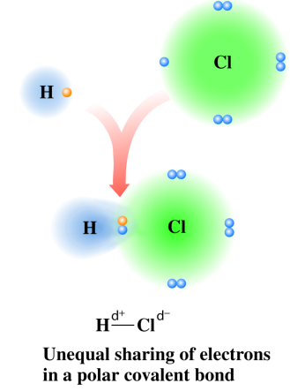

Electronegativity and Bond Polarity
Might look like a tree, but those branches are elements, and those roots at the bottom are actually electrons being shared and creating a polar covalent bond.

Slide 16
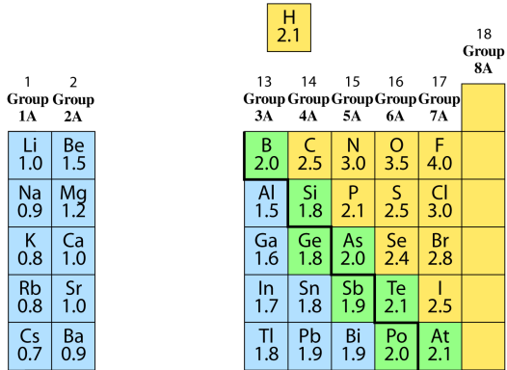
Some Electronegativity Values for Group A Elements
Electronegativity decreases
`
Electronegativity increases
High values
Low values

Slide 17
Nonpolar Covalent Bonds
A nonpolar covalent bond
occurs between nonmetals.
is an equal or almost equal sharing of electrons.
has almost no electronegativity difference (0.0 to 0.4).
Examples:
Electronegativity
Atoms Difference Type of Bond
N-N 3.0 - 3.0 = 0.0 Nonpolar covalent
Cl-Br 3.0 - 2.8 = 0.2 Nonpolar covalent
H-Si 2.1 - 1.8 = 0.3 Nonpolar covalent

Slide 18
Polar Covalent Bonds
A polar covalent bond
occurs between nonmetal atoms.
is an unequal sharing of electrons.
has a moderate electronegativity difference (0.5 to 1.7).
Examples:
Electronegativity
Atoms Difference Type of Bond
O-Cl 3.5 - 3.0 = 0.5 Polar covalent
Cl-C 3.0 - 2.5 = 0.5 Polar covalent
O-S 3.5 - 2.5 = 1.0 Polar covalent

Slide 19
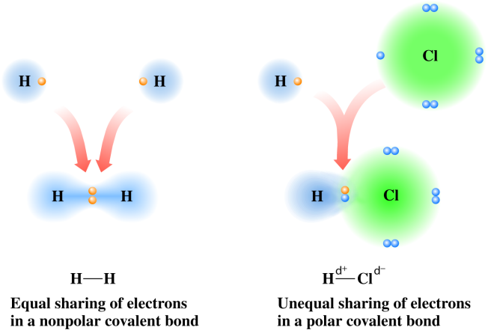
Comparing Nonpolar and Polar Covalent Bonds
Recap
Copyright © 2005 by Pearson Education, Inc.
Publishing as Benjamin Cummings

Slide 20
Ionic Bonds
An ionic bond
occurs between metal and nonmetal ions.
is a result of electron transfer.
has a large electronegativity difference (1.8 or more).
Examples:
Electronegativity
Atoms Difference Type of Bond
Cl-K 3.0 – 0.8 = 2.2 Ionic
N-Na 3.0 – 0.9 = 2.1 Ionic
S-Cs 2.5 – 0.7 = 1.8 Ionic

Slide 21
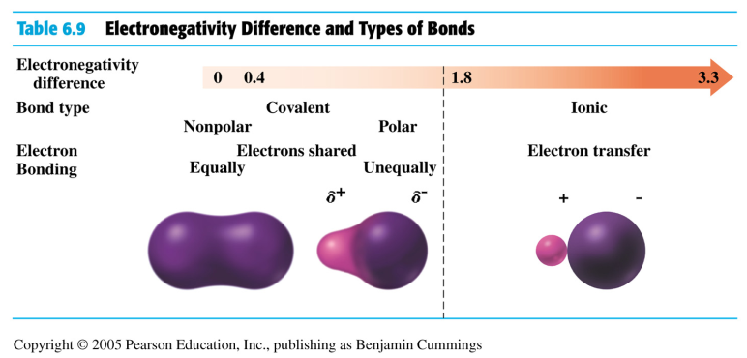
Electronegativity and Bond Types
TABLE 4.14

Slide 22
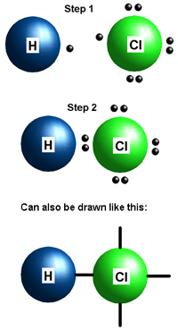
Hydrogen bonds
Hydrogen gives up its only electron and becomes a lonely proton. These are covalent bonds.
Hydrochloric acid
Alright. 4 kinds of bonds. Names?
Non-polar
Polar
Covalent
Metallic
Hydrogen fits into Covalent because the electrons are not being shared, but taken.

Slide 23
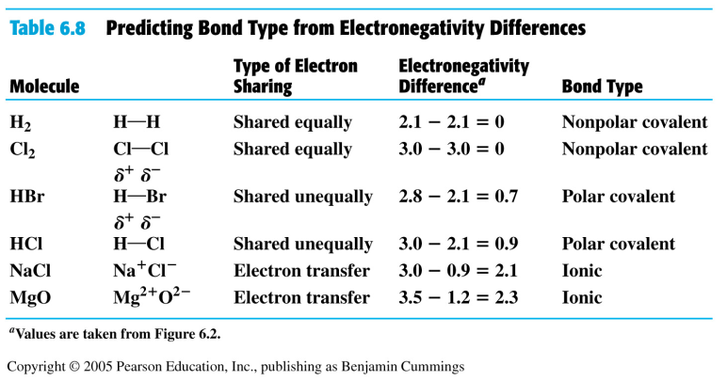

Predicting Bond Types
When electrons are shared equally, there is no electronegativity difference. The more unequal the sharing though, the larger the electronegativity difference.

Slide 24
Learning Check
Use the electronegativity difference to identify the type of bond between the following:
nonpolar covalent (NP), polar covalent (P), or
ionic (I).
A. K-N
B. N-O
C. Cl-Cl
D. H-Cl

Slide 25
Solution
Use the electronegativity difference to identify the type of bond between the following:
nonpolar covalent (NP), polar covalent (P), or
ionic (I).
A. K-N 2.2 ionic (I)
B. N-O 0.5 polar covalent (P)
C. Cl-Cl 0.0 nonpolar covalent (NP)
D. H-Cl 0.9 polar covalent (P)

Slide 26
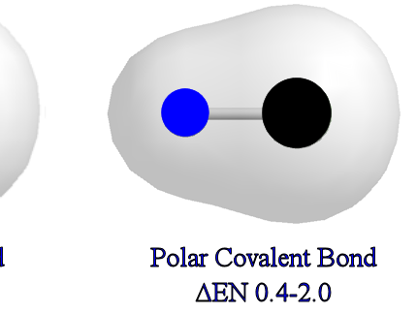
A BOND is polar if
You calculate it to be.
If electrons are pulled closer to 1 atom than another.

Slide 27
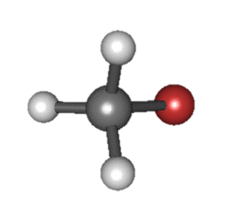
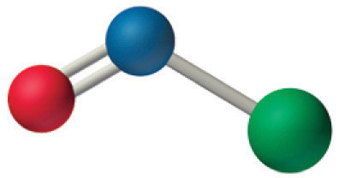
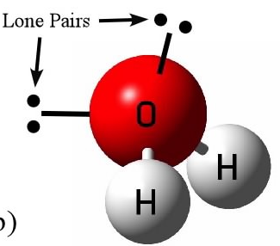
A MOLECULE is polar if
If it has a non-symmetrical shape
If it has “lone pair” electrons around the central atom, it is probably polar

Slide 28
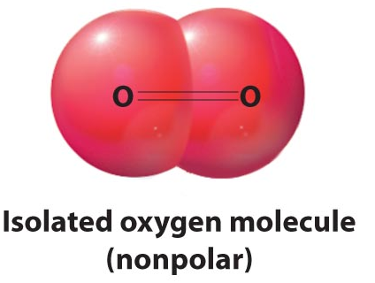
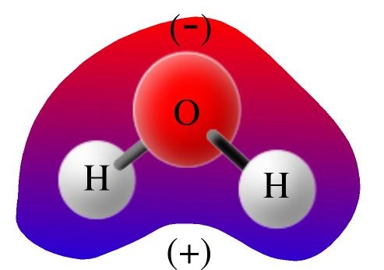
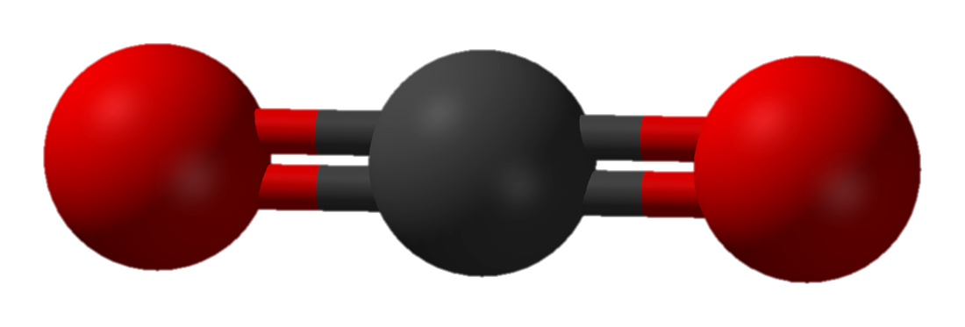
A MOLECULE is polar if
If a molecule contains oxygen, it is probably going to be polar but don’t be fooled.
Can you draw a line and divide it equally in every direction? If not, then it’s probably polar.
Nonpolar
Polar

Slide 29
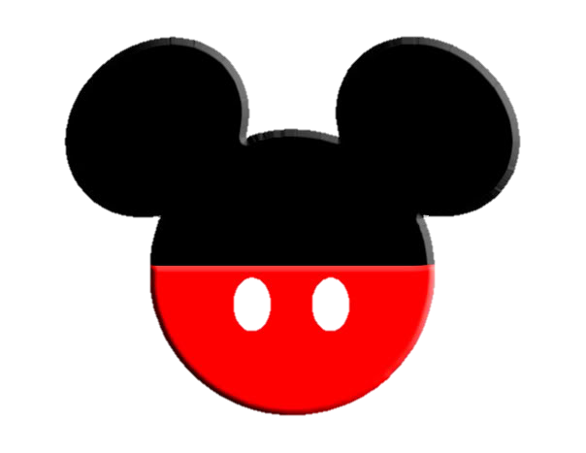


Polar Molecules Fun
An easy way to remember information is to link it with previously stored information in your brain. Like so:
The Isolated nonpolar molecule looks like Baymax’s head, the Polar molecule looks like Micky Mouse head, and the Nonpolar molecule looks like a tie fighter from Star Wars.

Slide 30

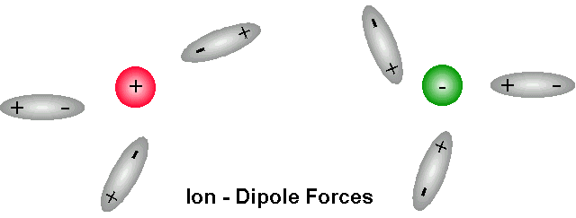
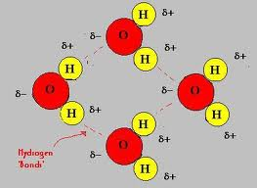
Dipole – Dipole Interactions
Very simply, they are the positive end on one molecule being attracted to the negative end of another molecule.
Molecular dipole forces.

Slide 31
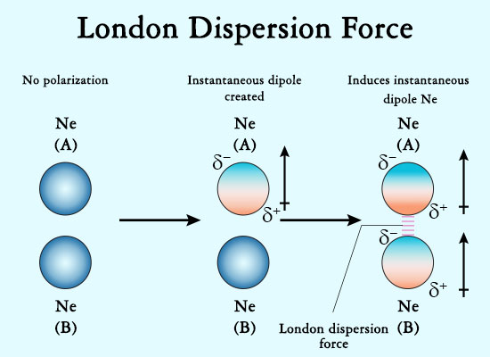
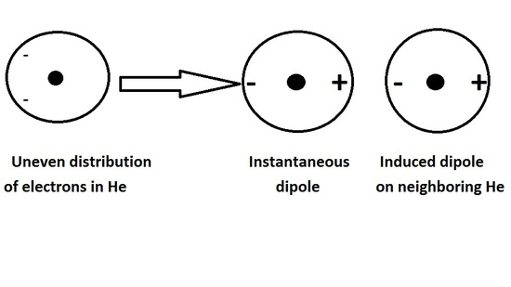
London Dispersion Forces
Dipoles induced within a molecule.

Slide 32
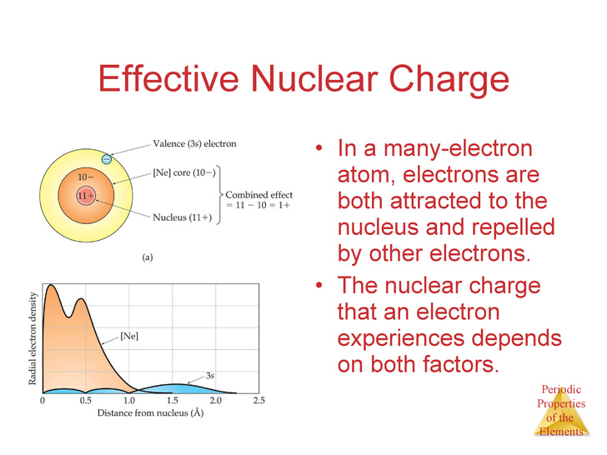
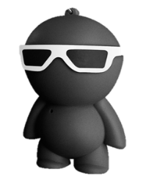
Effective Nuclear Charge
It’s a push and pull effect. The atoms want the nucleus, but not the electron’s negativity.

Slide 33
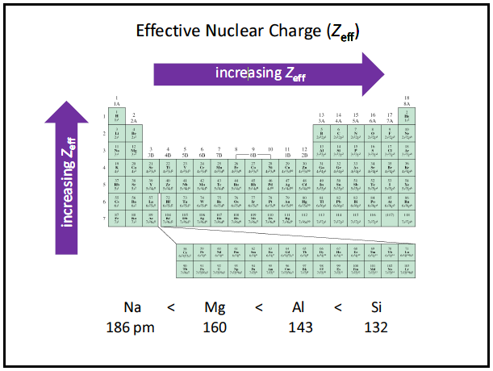
Effective Nuclear Charge
The farther right and up you move on the periodic table, the more effective the nuclear charge is.

Slide 34
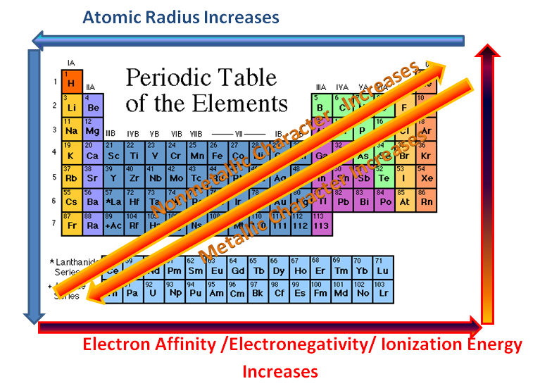
Periodic Trends

Slide 35
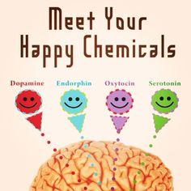
Bonding Between Monogamous Creatures
God’s Plan:
Men – dopamine & serotonin
  Vasopressin
Women – dopamine & serotonin
  Oxytocin
Male = Vasopressin
Women = Oxytocin

Slide 36
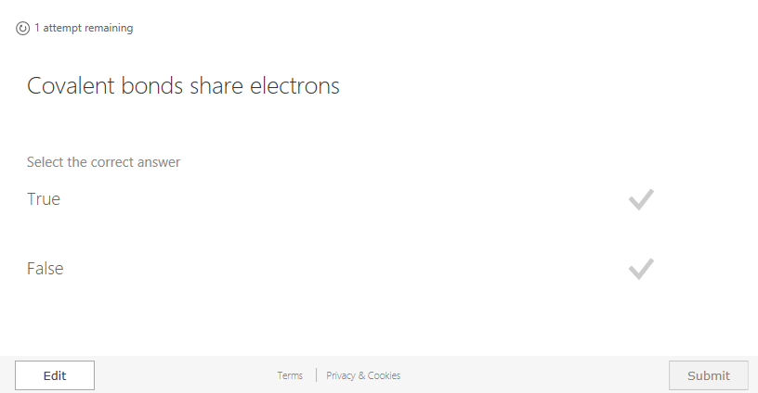
Challenge #1

Slide 37
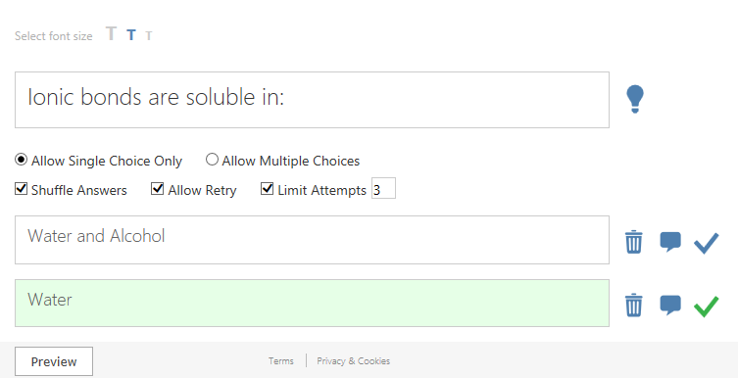
Challenge #2

Slide 38
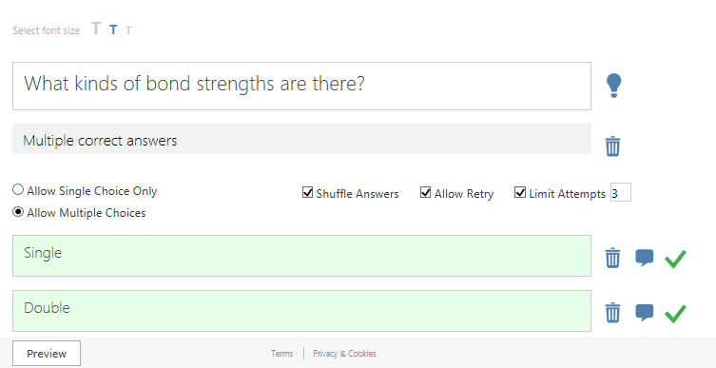
Challenge #3

Slide 39
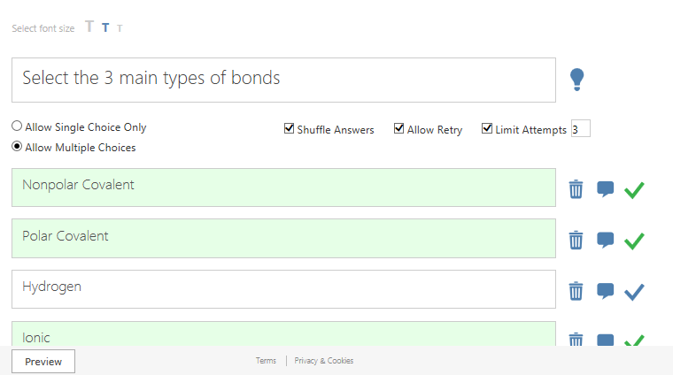
Challenge #4

Slide 40
