Slide 1
Electronegativity And polarity
QUEST Organic Chemistry

Slide 2
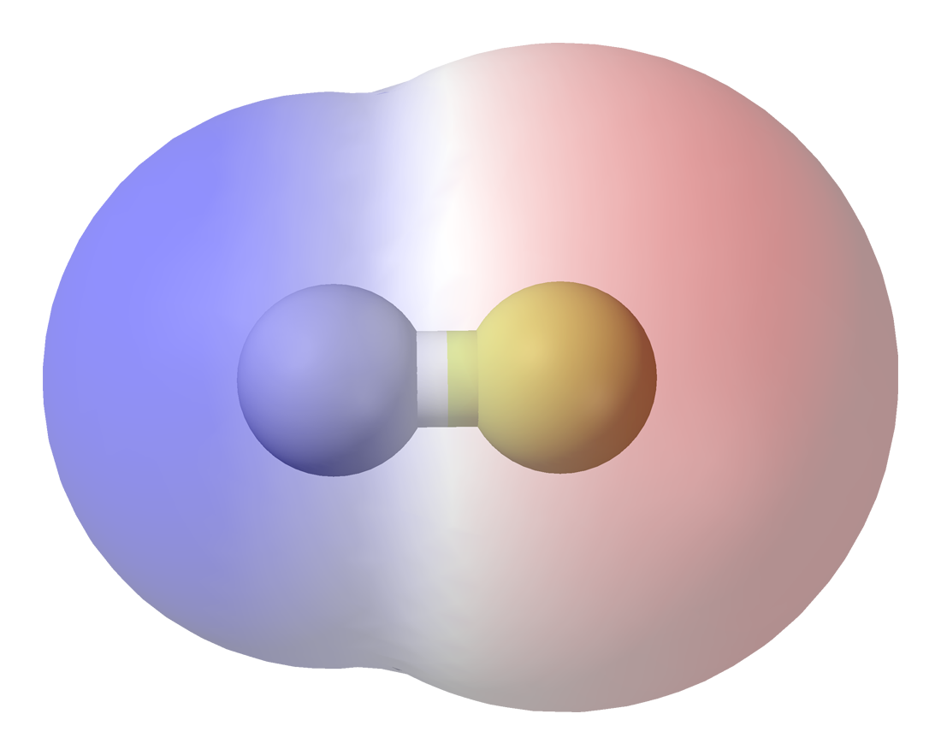
Electronegativity
Electronegativity values are a measure of the power of an atom in a molecule to attract electrons to itself.
Fluorine is the most electronegative at 3.98
All other values are relative to that; Francium is the least at 0.7
Symbol: χ (chi)

Slide 3
Electronegativity
Tends to INCREASE left to right across the table
Tends to DECREASE going down a column
Why?
Chart of all electronegativity values:

Slide 4
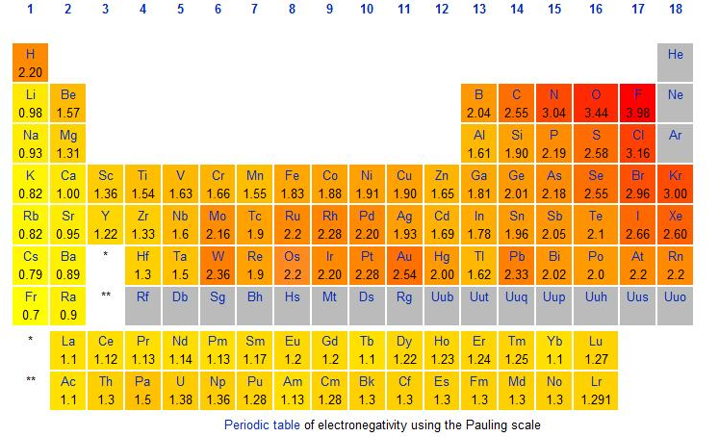

Slide 5
Bonding
In a covalent bond, the electrons are shared between the atoms.
However, the electrons will spend MORE time at the more electronegative atom, creating a partial negative charge.
For example, HF molecule
Fluorine has χ = 3.98
Hydrogen has χ = 2.20
Electrons are more attracted to fluorine, giving it a partial negative.

Slide 6
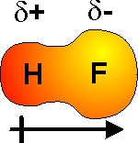
Partial charges
Represented with lowercase delta and charge: δ+ or δ-
Or with notched arrow from positive to negative:

Slide 7
Polarity
If there is a charge difference, then the bond is polar
A polar molecule is one in which one side, or end, of the molecule has a slight positive charge and the other side, or end, has a slight negative charge.
We classify bond types based on the DIFFERENCE in electronegativity between the two atoms.
Subtract the smaller electronegativity value from the larger.

Slide 8
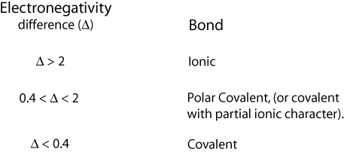
1.8
1.8

Slide 9
Polarity
Example:
C-S bond
C = 2.55
S = 2.58
2.58 - 2.55 = 0.03
Nonpolar covalent bond

Slide 10
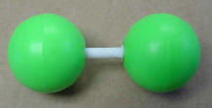
Simple example of nonpolarity
A homo- nuclear diatomic will always be nonpolar because it is exactly symmetric.
Chlorine Cl₂

Slide 11
Polarity
Try these examples using the table:
H–Br bond
P–F bond
Na–Cl bond
N–F bond
C–I bond
Br–Br bond

Slide 12
Overall polarity for molecules

Slide 13
Dipole Moment
A molecule that has a center of positive charge and a center of negative charge
dipolar

Slide 14
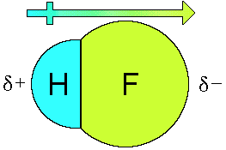
Dipole moment
If there is just one bond (2 atoms) in the molecule, it is easy.
The dipole for the molecule is the same as for the bond.
H-F
+-->
Any polar bond will show a dipole moment

Slide 15
Dipole moments
If there are more than one bonds, you will have to figure out the 3-D structure with VSEPR, add up the dipoles and see the overall dipole direction.
Draw the dipole for:
H2O
NH3

Slide 16
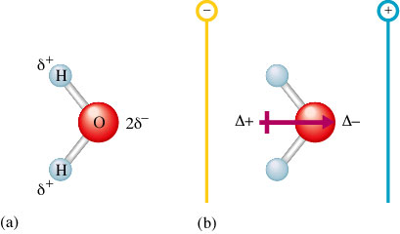

Slide 17
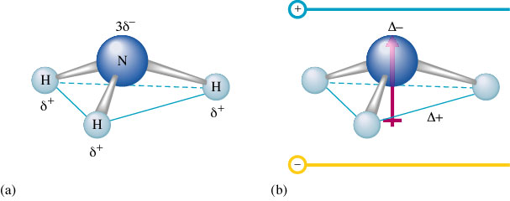

Slide 18
Even if all the outer atoms are the same, a molecule with an asymmetric shape will be (at least slightly) polar.

Slide 19
Polar bond, but no dipole?
Occurs when individual bond polarities are arranged in a way where they cancel each other out

Slide 21
symmetric

Slide 22
nonpolar

Slide 23
No overall dipole

Slide 24
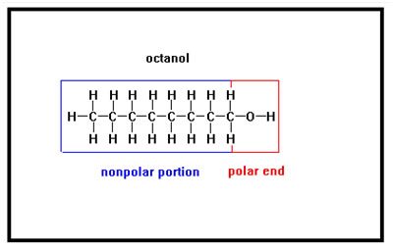
Large Molecules
When a large molecule, the size of octane or larger, contains only one or two polar bonds, even though the molecule overall is polar, it behaves in many ways like a nonpolar molecule.
Such a molecule will generally have a higher boiling and melting point than a molecule of equal size with no polar bonds.

Slide 26
Hands on practice
Build the molecule. On a separate paper, list the polarity of the bonds, draw the Lewis structure and overall state whether the molecule is polar or not.
NH3 O3
H2O BH3
SO3 PCl3
SO2
CH3Cl
HCN
CH2O

Slide 27
CH₄: nonpolar bonds (or very slightly polar), nonpolar molecule
NH₃: polar bonds, polar molecule
H₂O: polar bonds, polar molecule
SO₃: polar bonds, nonpolar molecule
SO₂: polar bonds, polar molecule
CH₃Cl: polar bond (C-Cl), polar molecule
HCN: polar bond (C-N), polar molecule
CH₂O: polar bond (C-O), polar molecule
O₃: nonpolar bond, polar molecule (lone pair on the central O)
BH₃: polar bonds, nonpolar molecule
PCl₃: polar bonds, polar molecule

Slide 28
What about VERY large molecules?

Slide 29
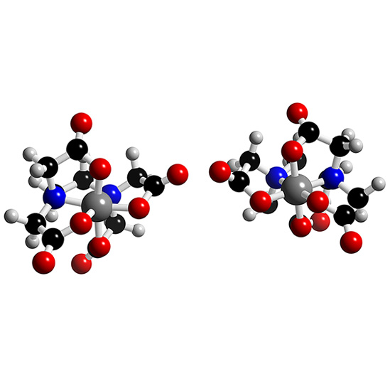
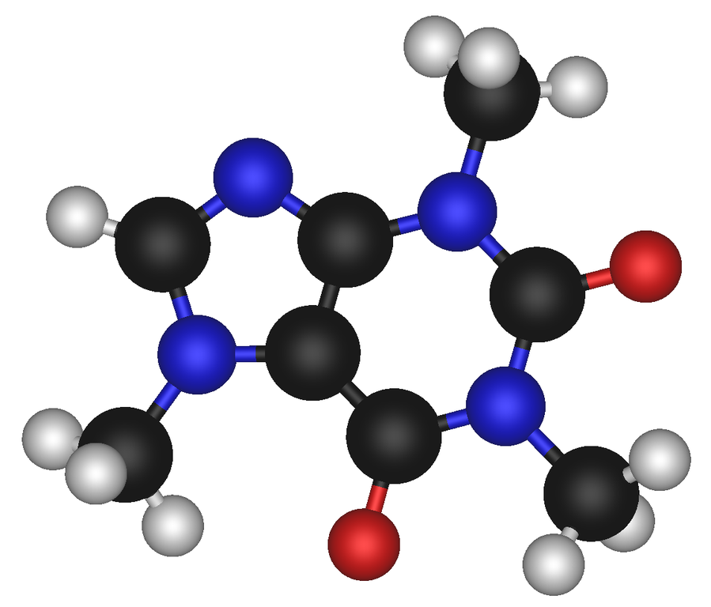
Large organic molecules
Large organic molecules, like he one below, can contain many different dipoles that are to complicated to add up.

Slide 30
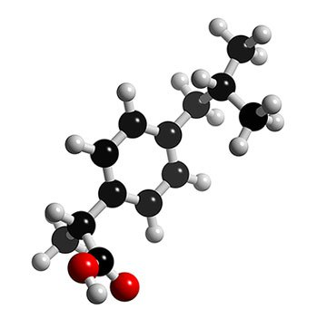
Large organic molecules
Sometimes, a molecule may even have different polarities in different regions.
For example, it may have a few OH groups that make one part of it very polar, while the other side may contain a long carbon chain that is more attracted to nonpolar molecules.

Slide 31
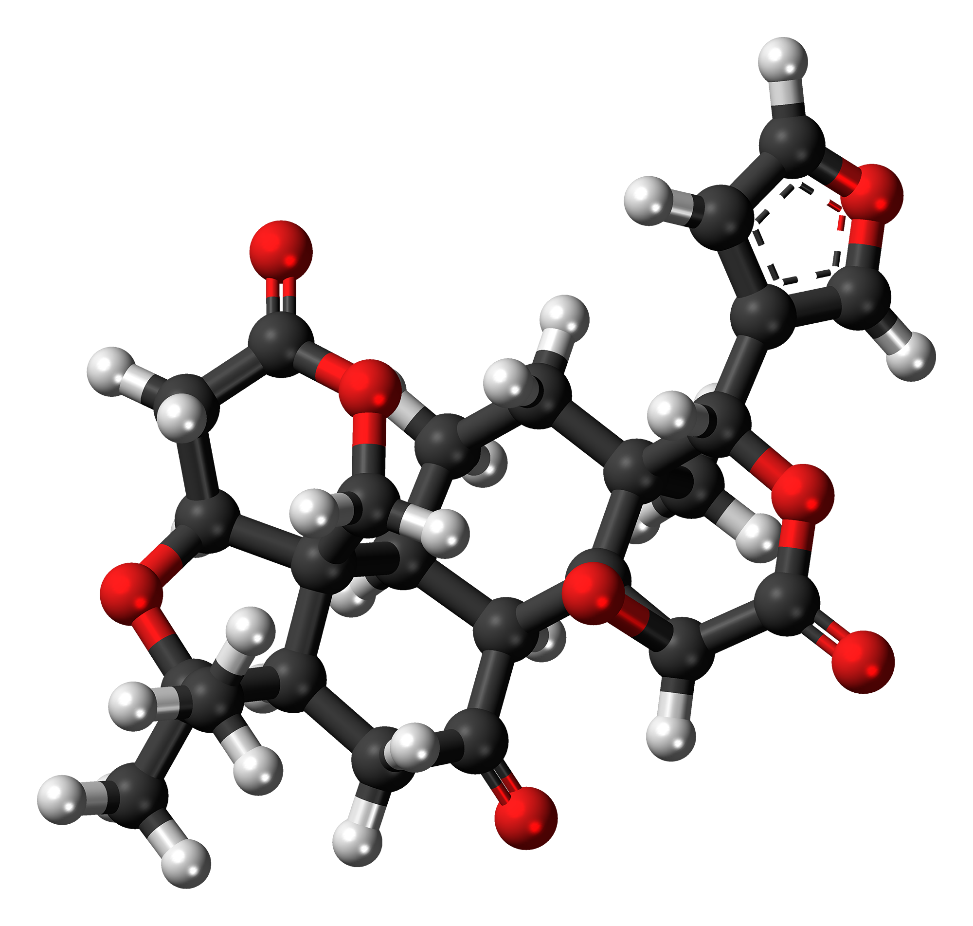
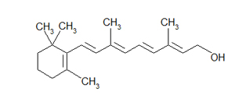
Oxygen
Usually, the molecule with a higher density of oxygen atoms will tend to be more polar. (The same is true to a lesser extent for nitrogen)
You can use this to predict how molecules will behave in lab techniques such as chromatography and dyeing.

