Slide 1
Get a Job
Dream it, Find it, Get it, Love it

Slide 2
Get the job
Find & Apply
Resume & Cover Letter
Interview & Thank You

Slide 3
Find it…
Online
Newspaper
Employment Agencies
Networking
Job Fairs

Slide 4
Job Application
Get the job
Find & Apply
Get a Job

Slide 5
What is a job application?
First Impression
Shows Qualifications
Compares Applicants
Be neat & professional
Experience & skills
Who best meets qualifications
References
A written request for employment typically on a specific form provided by the potential employer.

Slide 6
Get the Application
Virtually
In Person
Proofread your writing
Follow directions on prompts
Dress appropriately
Visit during slow hours
Why is it unwise to ask for an application
at a dinner restaurant at 6pm?

Slide 7
Complete the Application
Read the entire Application
Follow All Instructions
Use Black Pen
Print, Scan or Type
Be Specific
Always list most recent experience & education first
No Abbreviations (N/A may be used)
Be Honest
Salary:
Negotiable is a good response
References
Ask in advance
Make additional copies of the application in case you make mistakes

Slide 8
Tips
Contact Information
Use a professional looking email address
Ensure your voicemail is appropriate
Check your spam in your email for responses
Check voicemail often
Why might an email such as samrowdy@gmail.com
be inappropriate?

Slide 9
Contact Information
To Do
Not to do
Write full name
List phone number & email
Social Security number
Draw a straight line
Write “will be given upon interview”
List an email that may give a bad impression
Have a rude voicemail
Let your voicemail get full
Have voicemail with music
List Social Security number
Create a T Chart & list what:
“to do”
and what
“not to do”
Listing your Social Security number
can result in identity theft.

Slide 10
In 2012 the average American held over 15 jobs.
What might job hopping
indicate to a
potential employer?
Meister, Jeanne. "Job Hopping Is the 'New Normal' for Millennials: Three Ways to Prevent a Human Resource Nightmare." Forbes. Forbes Magazine, 14 Aug. 2012. Web. 07 May 2014.

Slide 11
Changing Jobs Verbiage
To Do
Not to do
List Changes as:
List Changes as:
Seasonal
Better Opportunity
Seasonal Employment
Further Education
Fired
Hated Job
Disliked Boss
Mean Co-workers
Create a T Chart & list what:
“to do”
and what
“not to do”

Slide 12
References
Who to List
Who Not to List
Teachers
Coaches or Advisors
Former Employers
Counselor
Neighbor
Those you have volunteered for
Friends
Girlfriend or Boyfriend
Relatives
Classmates
Create a T Chart & list what:
“Who to”
and what
“Who not to”
Be sure to ask your references to ensure
they give positive information.

Slide 13
Turning in your Application
Dress appropriately
Be prepared to answer questions
Follow up within 3 days with a phone call
Assume you will be interviewed on the spot

Slide 14
Resume
Get the job
Resume & Cover Letter
Get a Job

Slide 15
What do you already know about cover letters and resumes?
Cover Letter
3-4 Paragraph Business Letter
Resume
Purpose: create interest so you can get an interview
1 Page Document
Summary of experience, abilities, and accomplishments

Slide 16
Resume Basics
Relevance
Only list items related to position desired
Fluid
A resume changes with you
Update as skills are learned
Neat
Professional font with bold used appropriately
No staples or folds
Typed
Utilize secondary career centers after college graduation

Slide 17
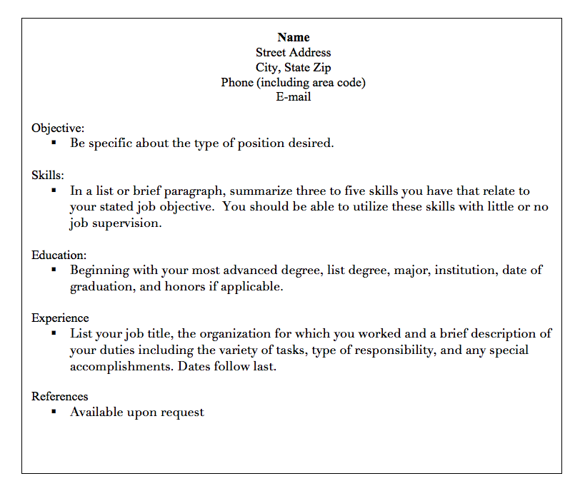
Combination Example
Is there anything missing on this resume?

Slide 18
What to include in a Resume
Heading
Name, Address,
Phone number
Professional Email
State the job type, industry
One Phrase
Optional
Objective
When is it a good idea to include an objective on a resume?

Slide 19
What to include in a Resume
Education
Graduated 2015 or Expect to Graduate 20xx
Position Title
Name of Organization
Location & Dates
Work History
List honors courses and GPA if GPA is above 3.0
Use “Action Words” to describe
List in chronological order

Slide 20
What to include in a Resume
References
Available Upon Request
Honors, Activities & Volunteer Work
Specific Name & Date
Leadership Roles
3 references & contact information typed on separate paper
Optional

Slide 21
Cover Letter
Get the job
Resume & Cover Letter
Get a Job

Slide 22
Cover Letter
State where you learned of the job opening
Add detail and personality to resume points
Persuade the potential employer that you are most qualified
Say thank you and list contact information
Ask for action in the last paragraph

Slide 23
Cover Letter Dissection
In your small group:
Use your tools and “dissect” the cover letter
Be prepared to share your discoveries
Answer Questions

Slide 24
Sender Address
&
Date
235 E. Pacific Street, Apt. 2B
San Francisco, CA 94115
May 13, 2014
Dr. Daniel Carter
Dean, General Studies Program
University of San Francisco
125 Height Street, Room 222
San Francisco, CA 94113
Dear Dr. Carter:
Name of the
Specific Person
you want to read the letter
and
Business Address
Punctuate with a Semicolon

Slide 25
Paragraph 1-Introduction
Why are you writing?
What job do you want?
How did you learn of the position?

Slide 26
Paragraph 2-The Sales Pitch
Evidence of qualifications
Why the job is desired
Highlighted achievements
Knowledge of the company
Reference to resume
What type of information did your
group say was included?

Slide 27
Paragraph 3-Close the Deal
Summarize
Offer the invitation of an interview

Slide 28
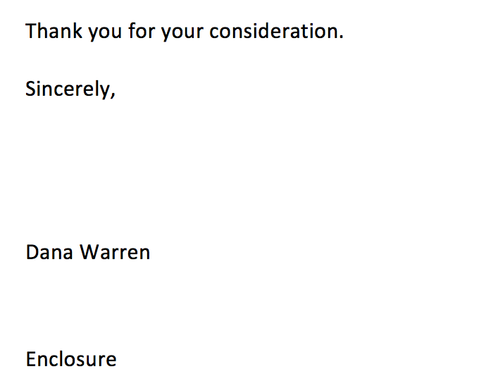
Finishing Details
Thank you
4 spaces for signature
Enclosure to indicate resume

Slide 29
Interview
Get the job
Interview & Thank You
Get a Job

Slide 30
The First Impression
Avoid Cologne
Limit Jewelry
Well Groomed

Slide 31
Interview
BEFORE
DURING
AFTER
Be Prepared
Be Professional
Be Thankful

Slide 32
Before
Review Interview FAQ’s
Review requirements
Make a list of questions to ask
Bring: resume, references
Dress professionally
Arrive 10-15 minutes early
Turn off devices
Find location

Slide 33
During
Be confident
Be courteous
Firm handshake
Make eye contact
Turn off devices
Ask questions
Think before responding
Speak slowly & clearly
No gum

Slide 34
Final Impression
Restate strengths
Let them know if you want the job
Be courteous
Ask when they will make a decision
Stand and shake hands

Slide 35
Virtual Interviews
Phone
Online
Stand
Ensure volume is okay
Don’t sit above webcam
Ensure quality bandwidth
Dress Professionally
What types of virtual interviews have you
heard of?

Slide 36
Follow Up
Get the job
Interview & Thank You
Get a Job

Slide 37
After The Interview
Why is it important to
take notes?
Make Notes
Write a Thank-you Letter
Discussion generated
Questions left unasked
Leaves a lasting impression
Helps you stand out from the crowd

Slide 38
Thank You Letter
Sincere appreciation
Reaffirm Interest
Emphasize how you fit their company
Type
Send within 24 hours

Slide 39
Calling after the Interview
Wait 2-3 days
Speak to the interviewer
Ask whether position has been filled
Ask for a timeline
Be gracious

Slide 40
Get the job
Find & Apply
Resume & Cover Letter
Interview & Thank You

