Slide 1
Newman Projections
Quest Organic Chemistry

Slide 2
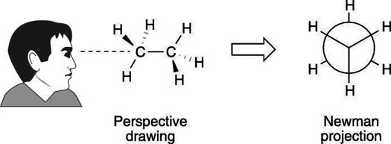
A Newman projection is what you would see if you looked down a carbon-carbon single bond lengthwise.

Slide 3
Usually, they look something like this.
Three hydrogens are in the
front, and three are in the back.
• Which are which?

Slide 4
The hydrogens in the front are
on the right carbon
The hydrogens in the back
are on the left carbon

Slide 5
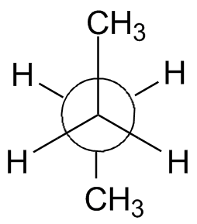
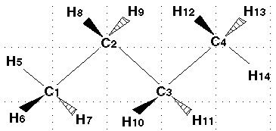
This means that the substituents going to the left on the Newman projection are actually coming out in front of the molecule (i.e. a wedge)
The substituents going to the right are behind the molecule (i.e. a dash)

Slide 6
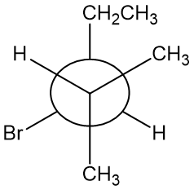
Practice
Can you draw the wedge-dash structure of this molecule?

Slide 7
Practice
Start by drawing the bond between the front and back carbons.

Slide 8
Practice
Next, we’ll add the substituents that are in the plane of the screen.
CH₃CH₂
CH₃

Slide 9
Practice
There will be two substituents coming out as wedges and two going back as dashes.
CH₃CH₂
CH₃

Slide 10
Practice
On the carbon on the right, a hydrogen is coming up and out, while a methyl group is going up and back.

Slide 11
Practice
H
CH₃
CH₃CH₂
CH₃

Slide 12
Practice
On the carbon on the left, a bromine is coming down and out, while a hydrogen is going down and back.

Slide 13
Practice
H
CH₃
CH₃CH₂
CH₃
H
Br

Slide 14
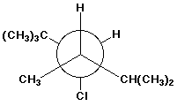
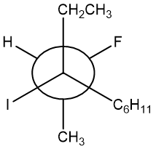
More practice
Draw the following molecules in traditional wedge-dash notation:

Slide 15
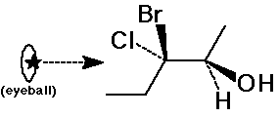
Even More Practice
Can you draw Newman projections for the following molecules down the indicated bonds?
Br
H₂N
HO
Ph
CH₂CH₃

