Slide 1
ANNOUNCEMENTS
November 27 - 29

Slide 2
Student announcements

Slide 3
Winter formal
Roaring 1920s Theme

Slide 4
Winter formal
Date: Friday, December 1st
Location:
St Odilia’s Parish Hall
Doors open at 5:45 pm
Social Hour 6 pm
Dinner served at 6:40 pm
Dance at 7:15 – 10:30
Time:

Slide 5
Winter formal
Josh Burgette will be offering photos!
Group, serious, and silly!
You will be able to download and print them yourself or buy a package from Quest.

Slide 6
Winter formal
Dress:
We will have a costume competition for the most authentic 1920s attire!
Prize for a girl and a boy costume.
Regular formal attire is also welcome.

Slide 7
Supper Club menu
Appetizers
Supper Salad
Entrées
Lobster Newburg
Steak Roulade
Chicken Picatta
Vegetable Turnover
Dessert Bar

Slide 8
Winter formal
Sign up online to attend dinner and the dance TODAY.
Submit song requests online. All music must be preapproved prior to the dance.

Slide 9
Gospel rescue mission – Christmas drive
Please drop off donations this week in the box outside Room 8
Help us help others by bringing in kid's and women's socks, children's bible's, hygiene products (toothbrush and toothpaste, shampoo and conditioner, and soap)

Slide 10
Tennis team needs you
Join us today!
Monday, Thursday at 3:15 PRACTICE.
Come out as often as you can. We will
teach you how to play.

Slide 11
Science fair TIP
The most important thing to do is practice your experiment!
A Hypothesis is an educated guess
The most important part of a hypothesis is the “because” statement!
Your wording should be "I hypothesize __________ because ___________.“
Visit or email Dr. Thai for help!
This Photo by Unknown Author is licensed under CC BY-SA

Slide 12
Student council hot lunch
December 4-6
Tacos! Tacos! Tacos!
$3 suggested donation
This Photo by Unknown Author is licensed under CC BY-NC-ND

Slide 13
Planning for college
HIGH SCHOOL STUDENTS!
SEE MRS MAGHRAN FOR HELP IN PLANNING YOUR PATH TO COLLEGE.
Make an appointment in the MPR for academic counseling.

Slide 15
Parent announcements

Slide 16
PLEASE SEE KATHRYN AT THE SIGN UP BOOTH OR IN THE OFFICE TO GER SIGNED UP FOR REMIND AND THE MESSAGE BOARD!
REMIND APP / COMMUNITY MESSAGE BOARD

Slide 17
Geography bee
Pima County Homeschool Geography Bee
December 1, 2017
1:00 - 3:00 p.m.
Firestation 380: 1175 W. Magee Rd.
Registration deadline: Wednesday, November 29th. $5/student $10/family
First, second and third prizes
Student must be homeschooled in grades 4 to 8, and must not have reached their 15th. birthday on or before Sept. 1, 2017
Contact Sandra Galasso at psgalasso@msn.com for registration.

Slide 18
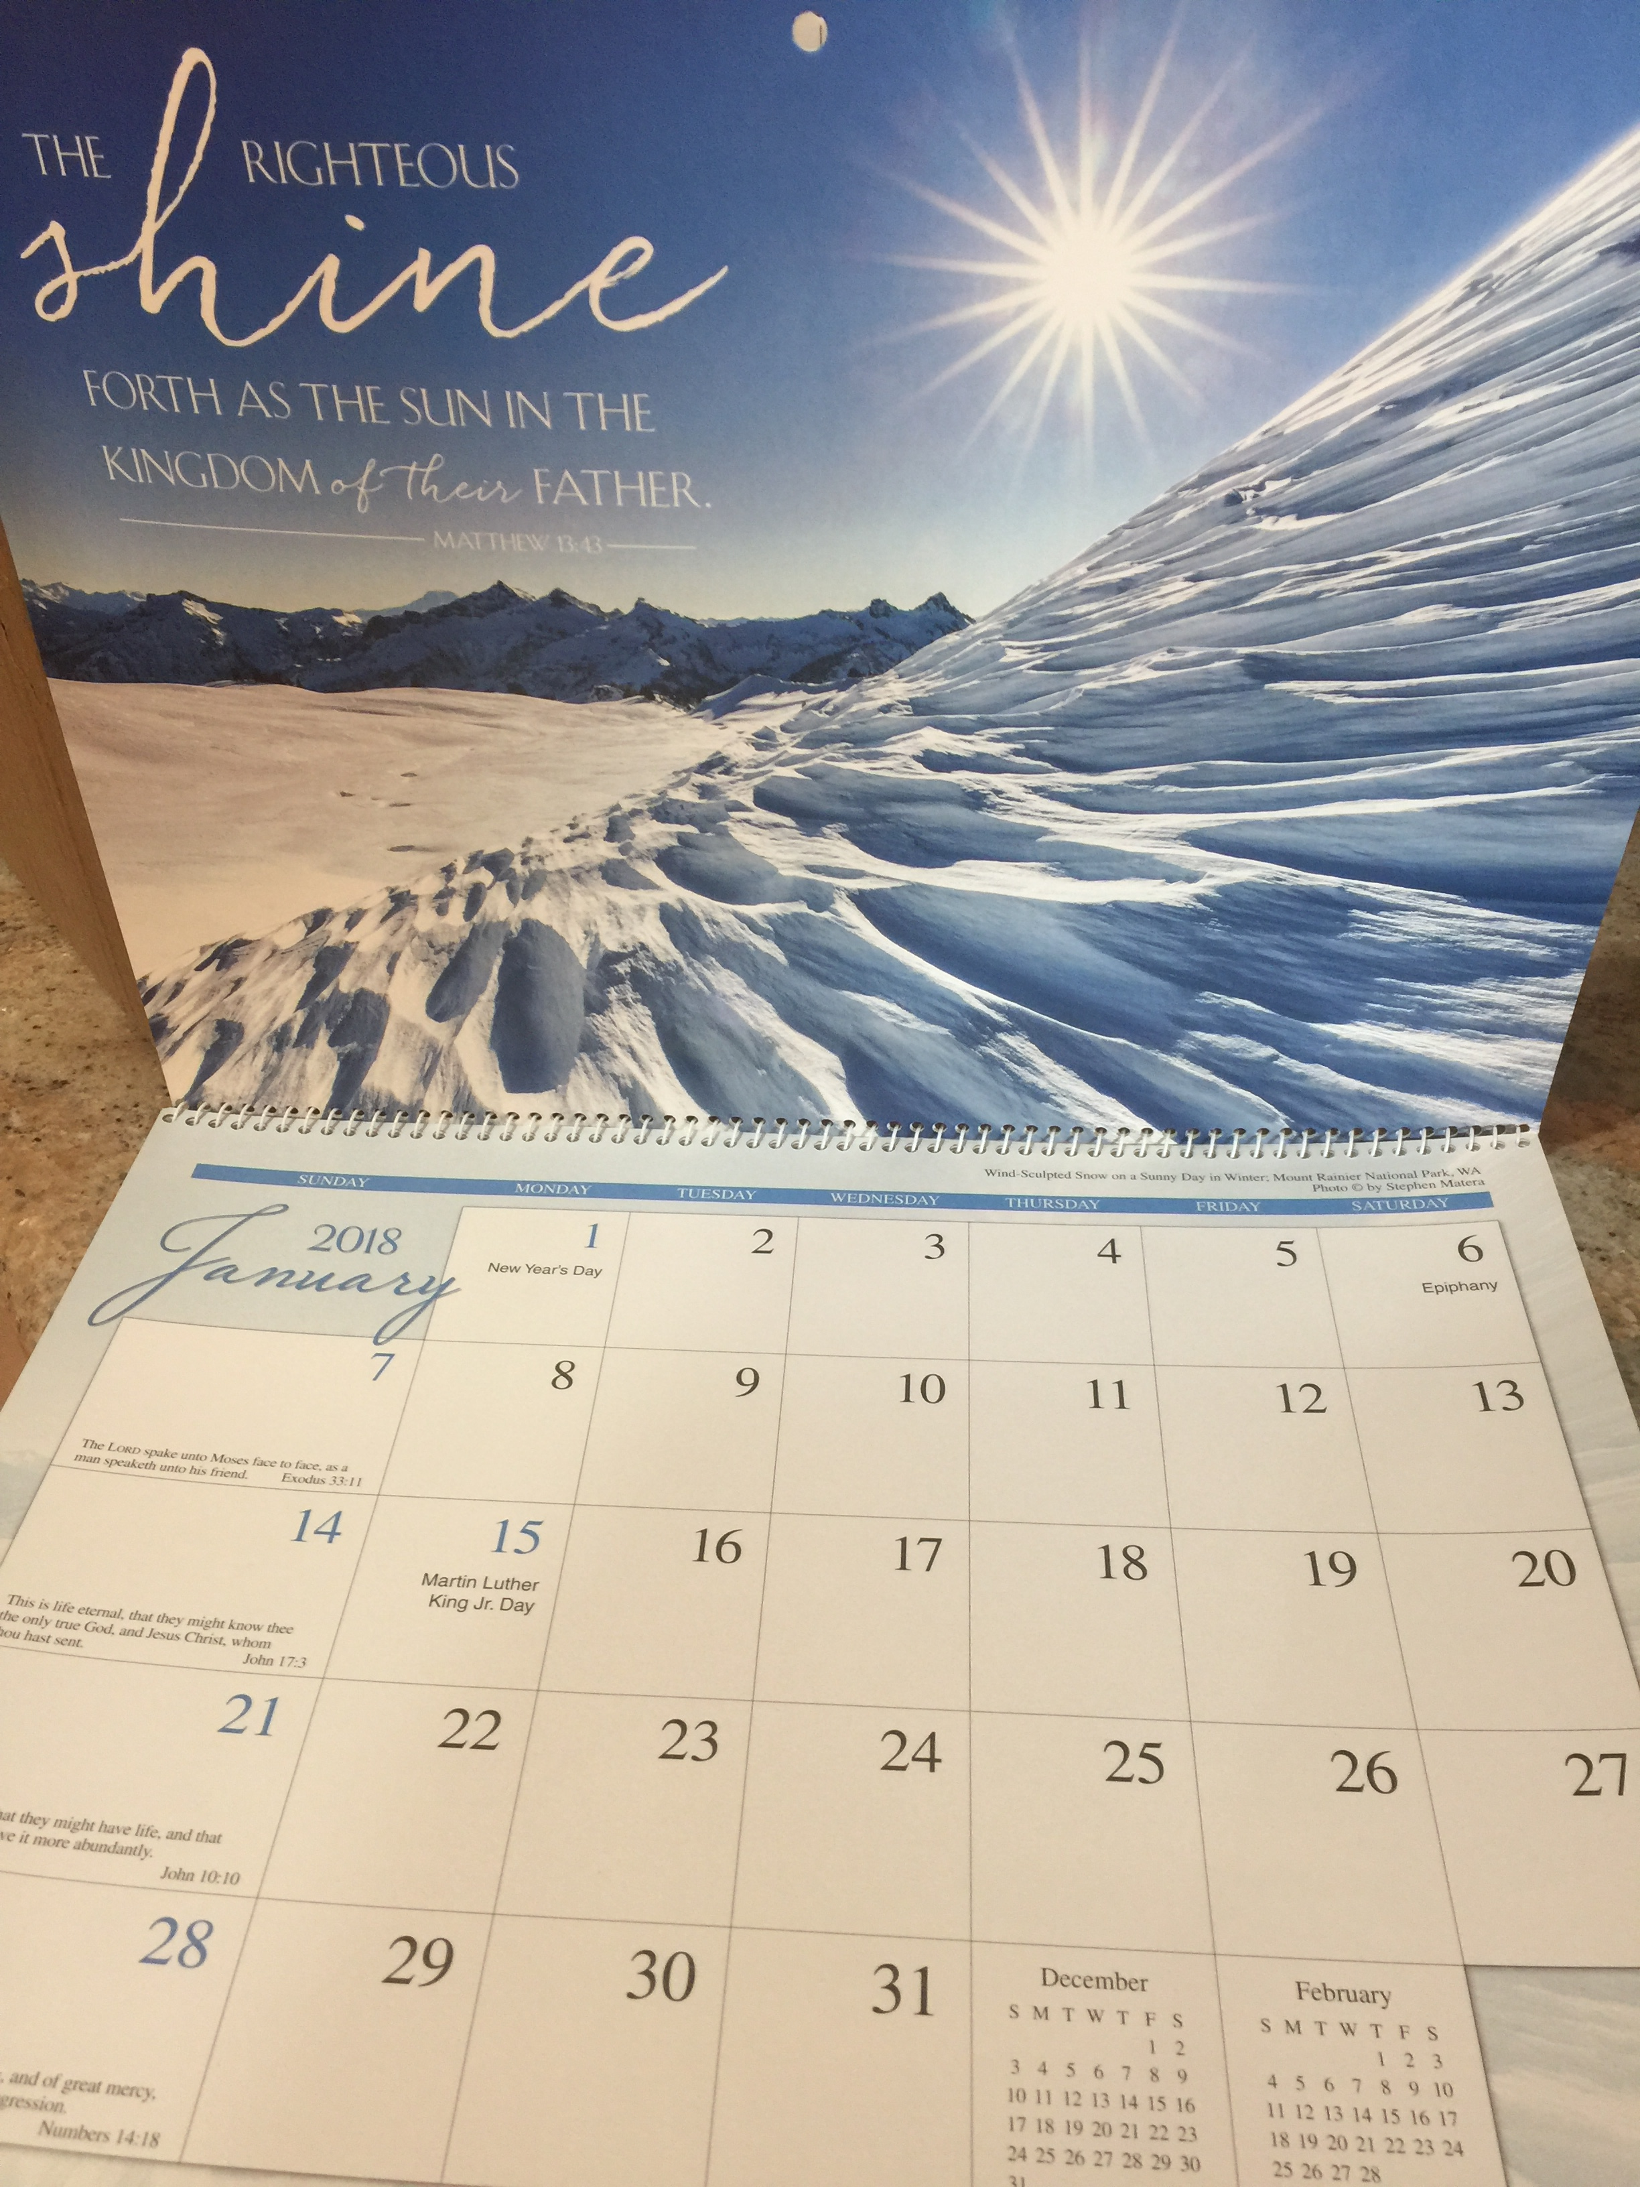
2018 calendars
These Calendars make beautiful Christmas gifts and everyone loves them! For sale now while supplies last!

Slide 19
Volunteers needed
We need volunteers to write thank you notes and cards for our families.
Please volunteer at the front desk.
This Photo by Unknown Author is licensed under CC BY
This Photo by Unknown Author is licensed under CC BY-NC-ND

Slide 20
Mister carwash fundraiser
Mister Carwash Fundraiser is open again until Winter Break!
Get yours today to give as gifts for teachers, teens, friends, family & yourself.
50% of proceeds go to Quest and credit toward Family Fundraising Account.
$12 Full, $6 Express
This Photo by Unknown Author is licensed under CC BY-SA

Slide 21
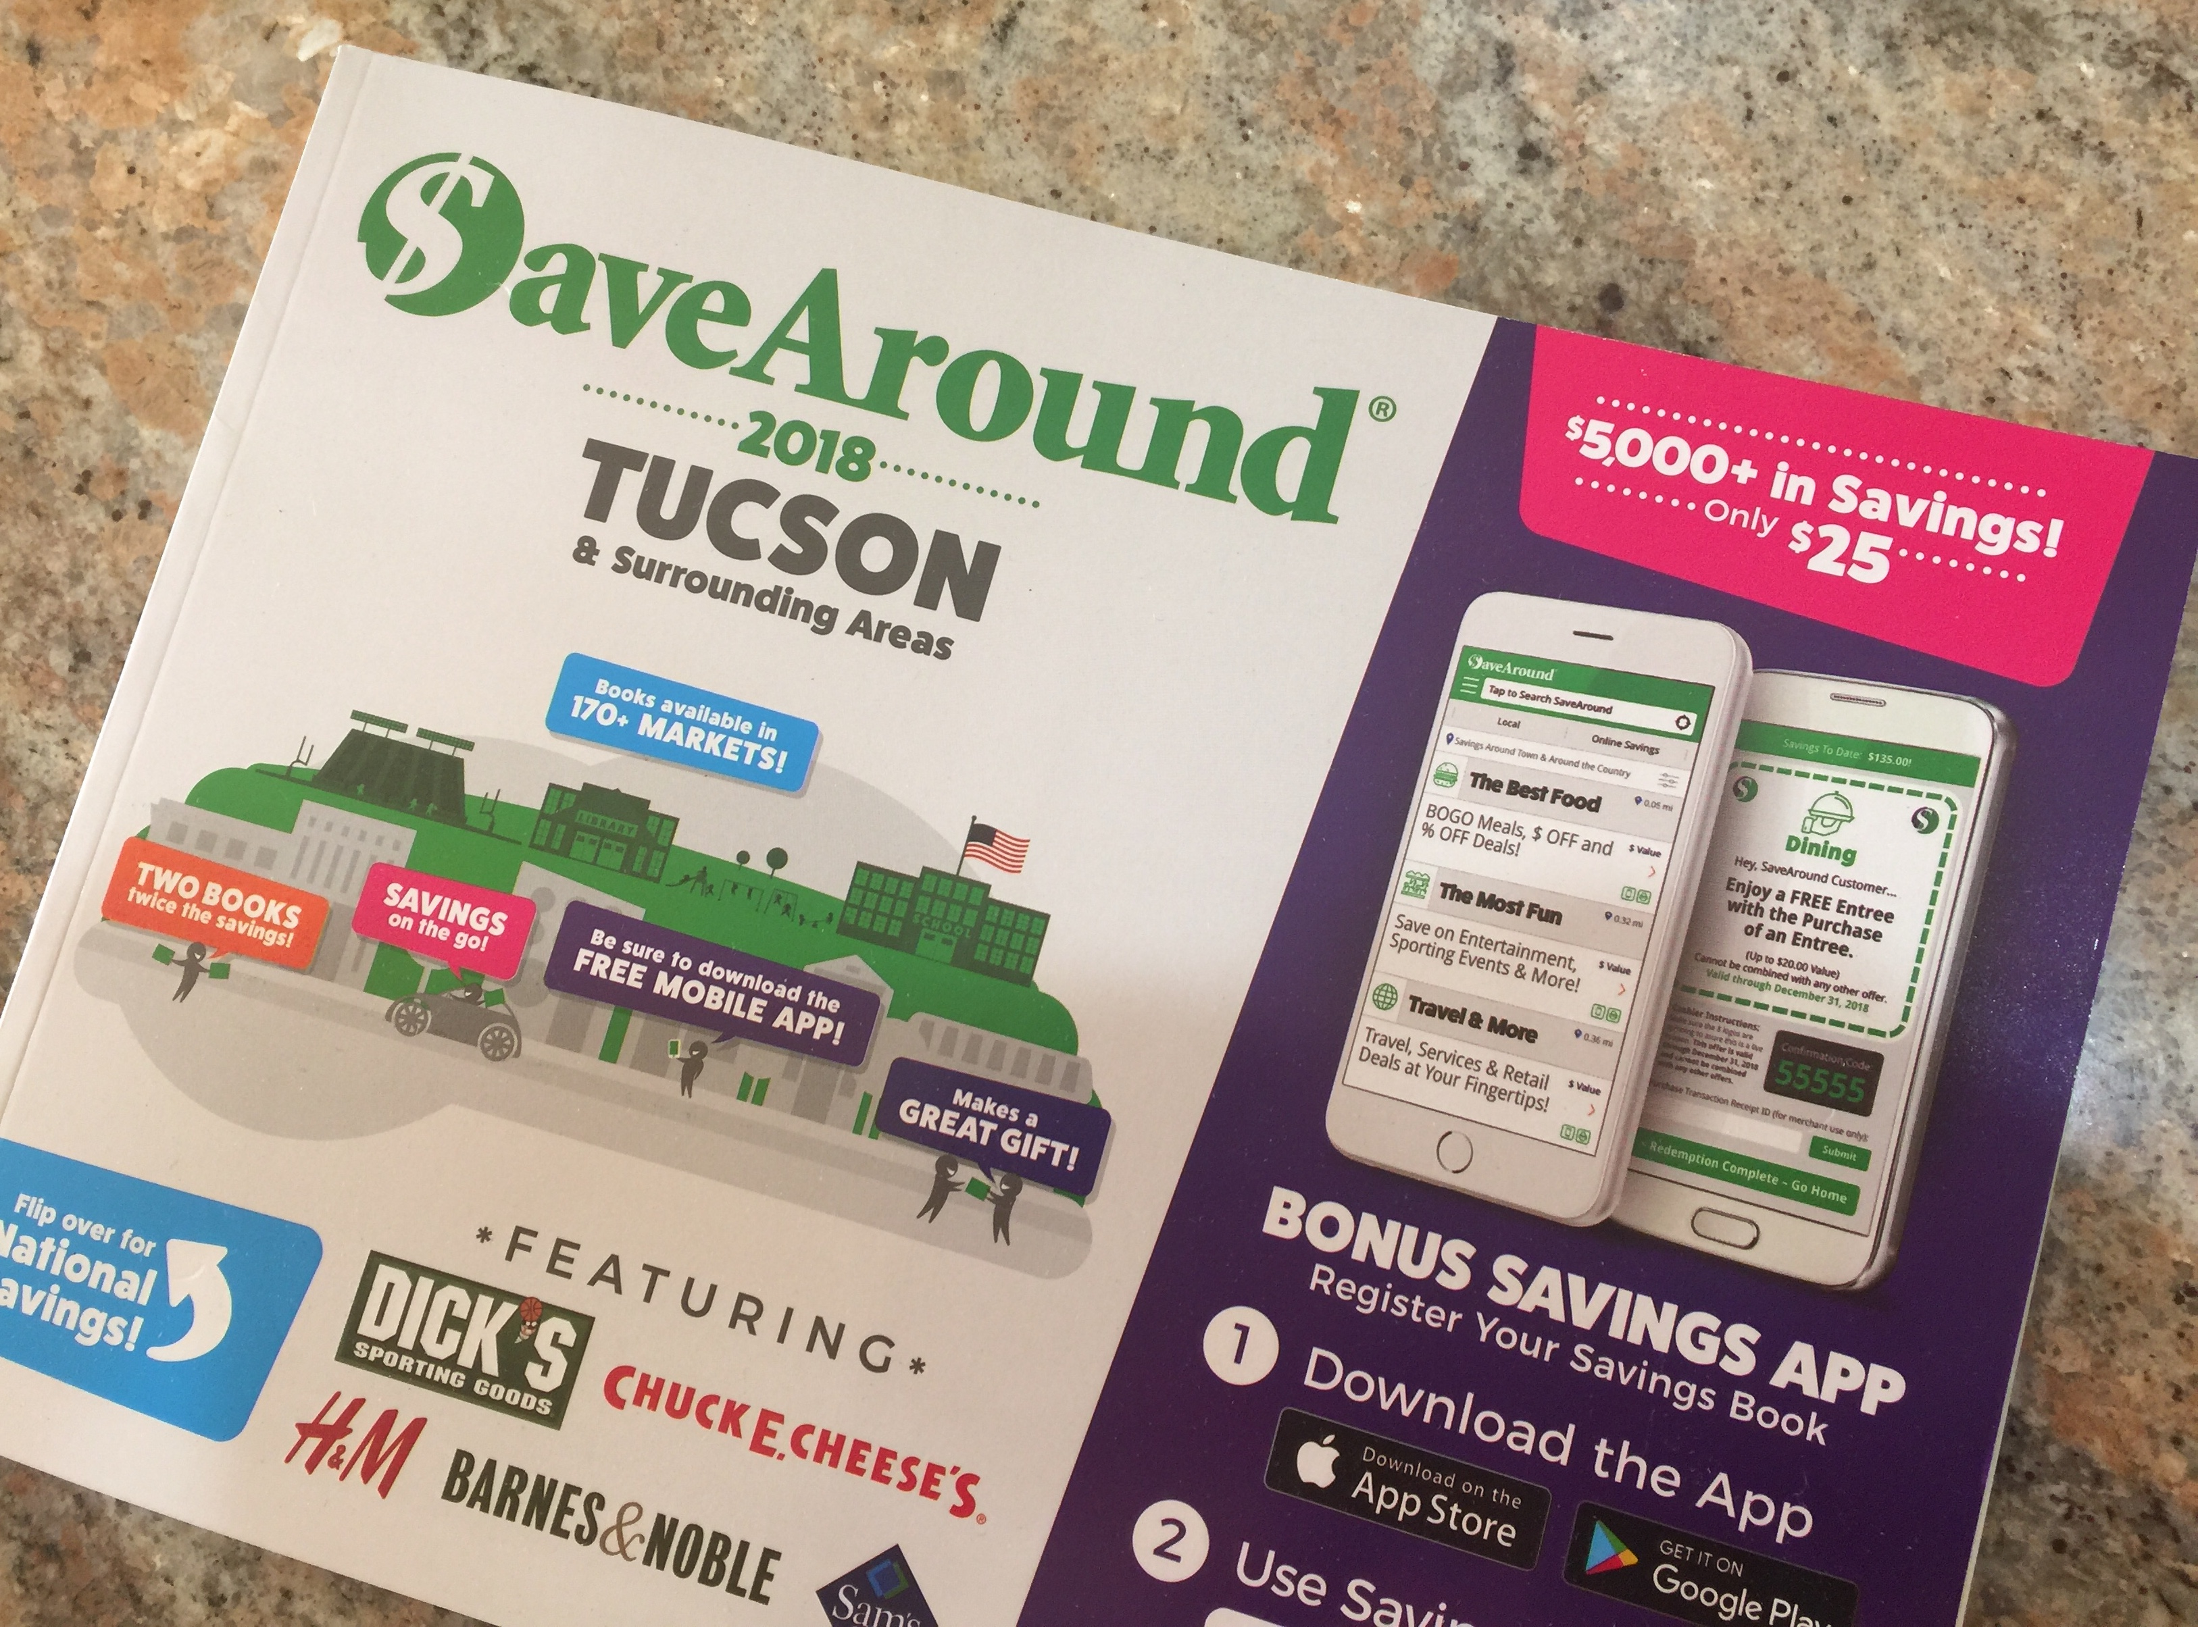
Coupon books
Save Around Tucson 2018 coupon book is selling for $25.
Using the coupons a couple of times pays for the book itself.
Ends December 6th. So get yours quick before they are gone!
Makes a wonderful gift!

Slide 22
Jim click fundraiser
Deadlnie is December 7th – ENDING SOON
Makes a great gift!!!
$25/each OR 5 for $100
The proceeds go to Quest and you will get credit for your Family Fundraising Account!
Drawing will take place on December 14th
Contact Angelic Ewing for details
This Photo by Unknow Author is licensed under CC BY-SA
This Photo by Unknown Author is licensed under CC BY-NC-SA

Slide 23
Donations needed
We need a used iPhone to serve as the Quest Front Desk phone!
If you have one to donate, or are willing to help, please see the front desk!
This Photo by Unknown Author is licensed under CC BY-SA

