Slide 1
Announcements
October 2 - 4

Slide 2
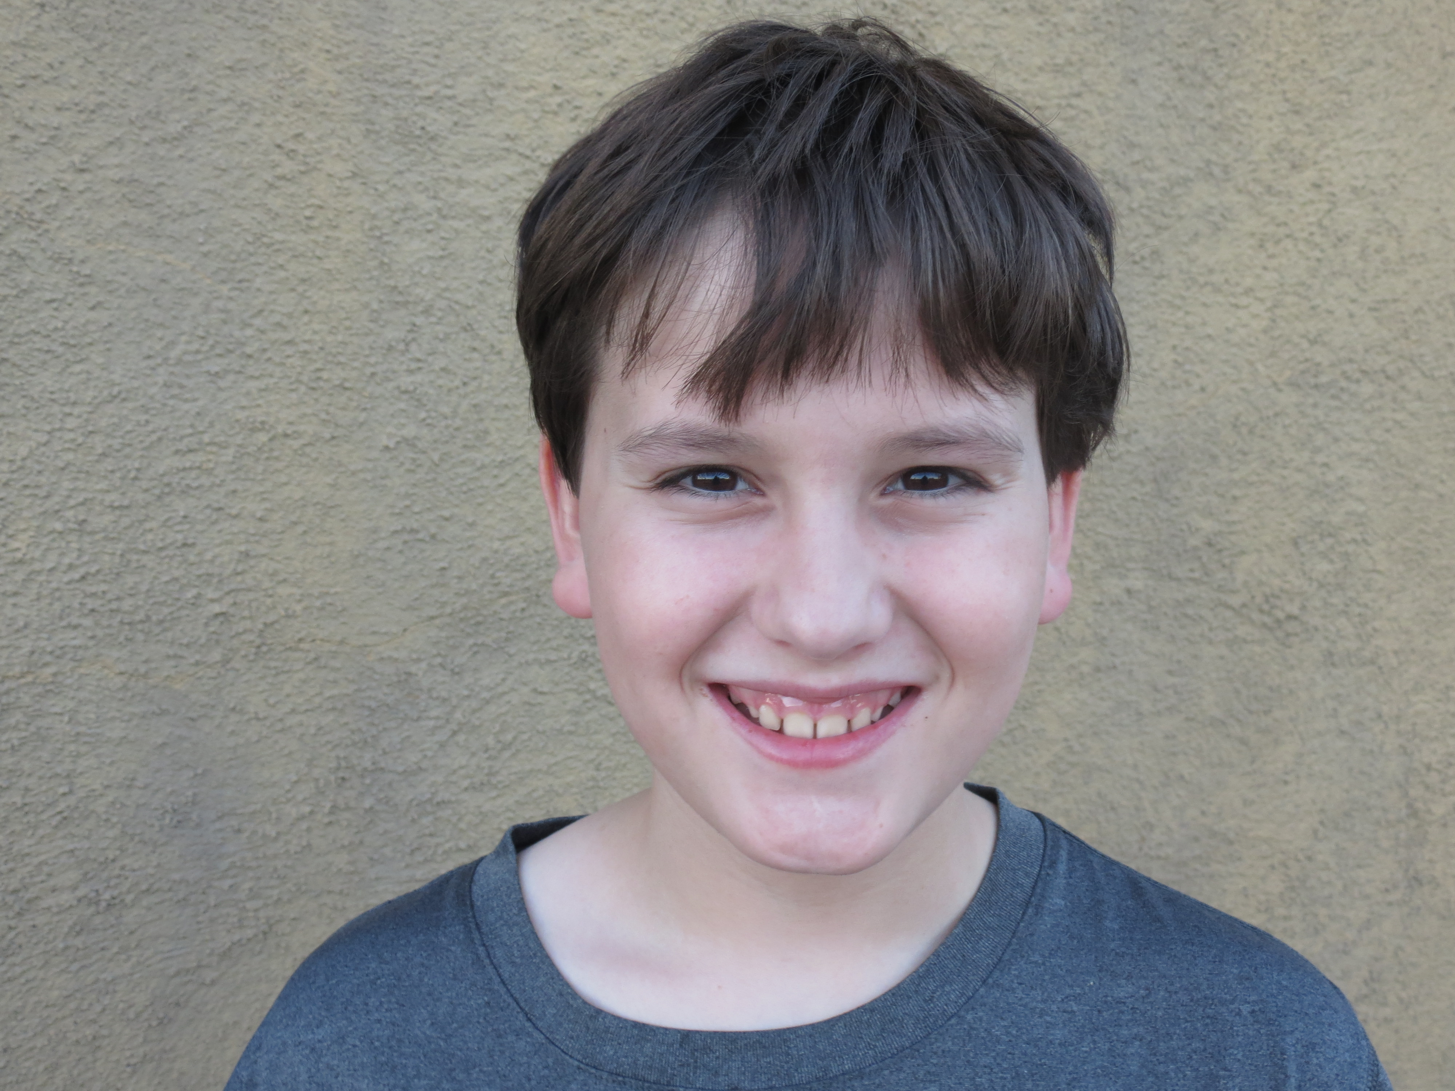
September Students of the month
Savannah Baird
Savannah Baird was selected as girl of the month. She has been wonderful in bringing in new kids and including them. She has really helped them make friends. She has persevered through her academics and is doing really well. She is a great example of good citizenship
Sam Miller
Sam Miller is boy of the month. He has been super helpful in getting Mrs. Taylor’s engineering class off to a great start. He is friendly and always willing to work. He comes up with great new ideas and is always willing to speak up and include others.

Slide 3
Outboxes
Outboxes are located in the MPR (Room 8)
Check these WEEKLY for graded assignments, announcements from teachers, and more!
This is YOUR responsibility!
Every student has a folder in the outbox.
This Photo by Unknown Author is licensed under CC BY-SA

Slide 4
College Freshman Giftboxes
Donate items to help fill up shoeboxes!
The care packages are going to our College Freshman
Donate through mid October in the breezeway

Slide 5
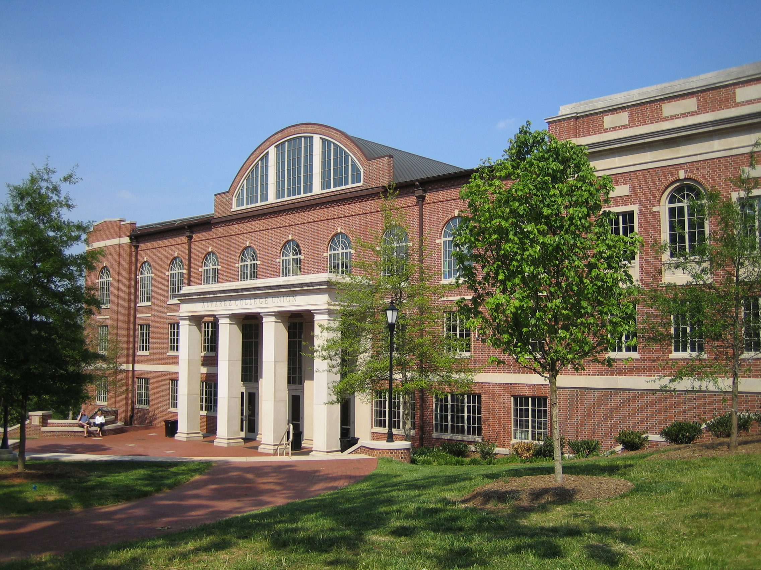
College night – October 12th
7pm in the Parish Hall – St. Odilias
Come learn the steps you need to take to get into college
Meet college reps
Learn about financial aid
Transcript help
How to make your application stand out
Military service before college?
Should you take a gap year?
This Photo by Unknown Author is licensed under CC BY-SA

Slide 6
forms
Please stop by the office to make sure you have filled out all mandatory forms!
This Photo by Unknown Author is licensed under CC BY-SA
This Photo by Unknown Author is licensed under CC BY-SA

Slide 7
Curriculum sale (mpr – room 8)
Visit the MPR and see the amazing selection of used curriculum!
Available for a reasonable donation.
This Photo by Unknown Author is licensed under CC BY-SA

Slide 8
Tutoring
Struggling in your classes?
Need help writing an essay?
Help needed with math?
Contact the Quest tutoring center for help in ALL of your subjects!
tutoring@questforeducationandarts.com
Sponsored by the ETA SIGMA ALPHA HONOR SOCIETY.
This Photo by Unknown Author is licensed under CC BY-SA

Slide 9
Fall gala silent auction donations
We are collecting donations for the silent auction
All proceeds will go to the Wesley Bilodeau Scholarship Fund
Individual items and full baskets accepted
Bring items to Mary Boxx-Hampton or Angelica Ewing with Name of Donor, phone number to reach you, a list of items in each basket, and the value of the basket.
This Photo by Unknown Author is licensed under CC BY-NC-SA

Slide 10
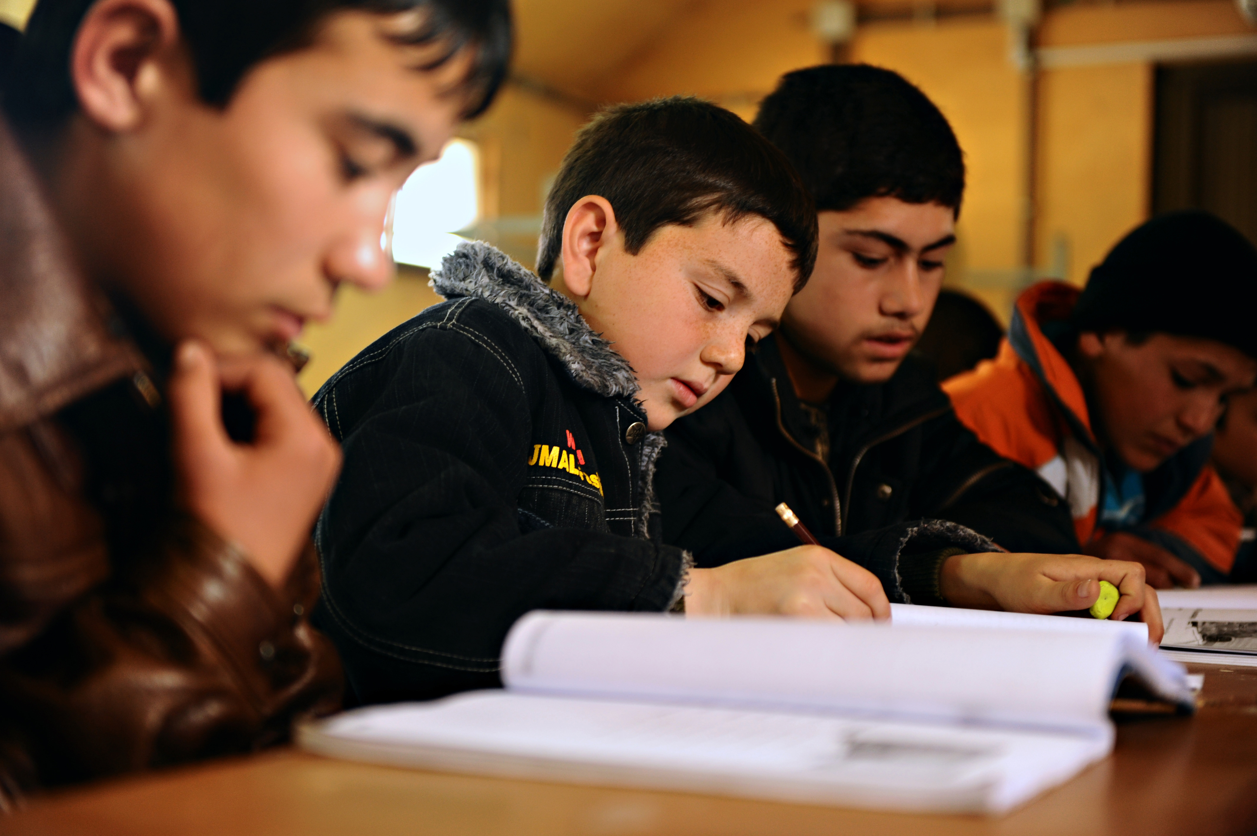
Study hall
Dr. Yarborough is available for homework help
He monitors Study Hall and would love you help you out!
Look for him in study hall each day.
This Photo by Unknown Author is licensed under CC BY-SA

Slide 11
3rd Annual Lego Night Competition
Friday, October 6th @ Oro Valley Church of the Nazarene
6pm – 8:30pm
Prizes for the best in each category!
An awesome night of family fun!
Spaghetti dinner - $3 donation

Slide 12
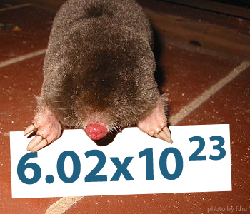
Mole day
Eta Sigma Alpha Honor Society is hosting Mole Day!
October 23, 24, 25
Come buy a piece of cake and celebrate the mole!
Make a Mole for a chance to win a prize in the mole making competition!
This Photo by Unknown Author is licensed under CC BY-NC-SA

Slide 13
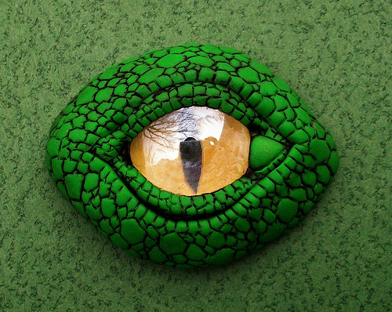
Comic-con art project
Come help us make dragon eye magnets for our booth at Tucson Comic-Con!
Help raise money for Quest!
Mrs. Boone will be in Room #1 on Oct 2nd 12:30-1:30 with supplies and instructions
Come have some fun and help Quest!
This Photo by Unknown Author is licensed under CC BY

