Slide 1
Announcements
September 18 - 20

Slide 2
Back to School Beach Bash!
Student Council Sponsored
Water games, food, and more! Bring a side to share!
Richardson Park – 3500 W Green Tees Dr.
Friday Sep 22 – 5-7:30pm
All families welcome!

Slide 3
Class Drop Deadline
Friday, September 22nd is the LAST DAY to drop classes without incurring the class drop fee.
Class drop fee: $100 per student, per class dropped after the deadline

Slide 4
Quest Snack Bar
Opens Sep 18th in Room 8
Buy your punch cards at the front desk! Available in $5, $10 & $20!
Cash will no longer be accepted at the snack bar.

Slide 5
Book Rentals
Book rentals are open!
We have text books available for multiple classes
Visit the front desk M-W to rent books and make payments.

Slide 6
Student Council Hot Lunch!
September 25-27
Nachos!
$3 suggested donation per serving
Pedro

Slide 7
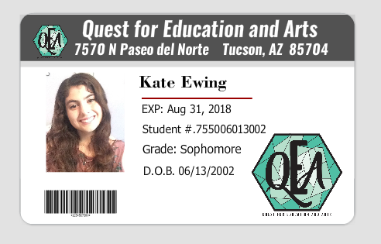
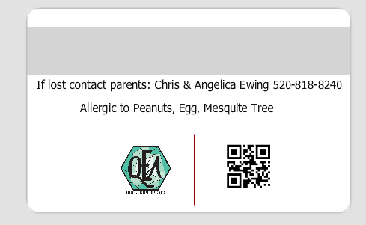
Order Your Student IDs
Purpose: - Will be used for check-in at Quest - Student Discounts around town (movies, museums, etc.) - Quest Library Rentals - Child identity card - Can have medical alerts
Cost: $10.00 donation per card (printed on high quality plastic)
See Angelica Ewing for details

Slide 8
3rd Annual Lego Night Competition
Friday, October 6th @ Oro Valley Church of the Nazarene
6pm – 8:30pm
Prizes for the best in each category!
An awesome night of family fun!

Slide 9
PSAT Testing for Juniors and Sophomores
ONLY 5 SPOTS LEFT!!
Registration closes Monday, September 18th
Wednesday, October 25th, $25 per student
Visit Ginger Maghran in the Student Resouce Center to sign up!

Slide 10
College Freshman Giftboxes
Donate items to help fill up shoeboxes!
The care packages are going to our College Freshman
Donate during the month of September in the breezeway

Slide 11
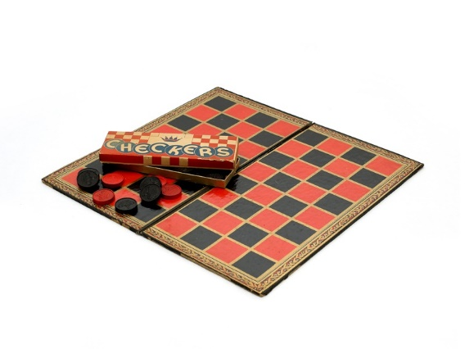
Student Resource Center
The new Student Resource Center (Room 8) is looking for donations!
Help them out by donating new/used legos, board games, cards, etc.

Slide 12
For the LORD gives wisdom; from His mouth come knowledge and understanding.
Proverbs 2:6

